Slide 1
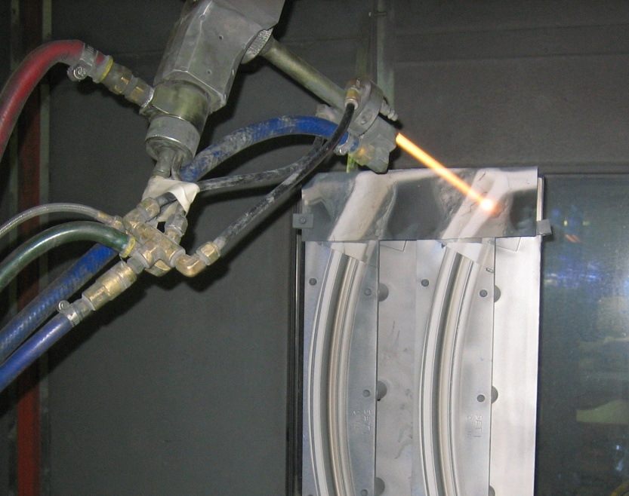
Some Viable Alternatives & Substitutes for Electroplating and Surface Finishing
Presented By:
Frank Altmayer, MSF, AESF Fellow, Technical Education Director, AESF Foundation/NASF

Slide 2
HVOF Spray vs. Hard Chromium
Powder is heated, at 2500-3100°C, to a plasticized state and is simultaneously propelled at >2600ft/sec. onto a surface
Coating consists of interlocking and bonded layers of thin lenticular particles, called splats, interspersed with voids
A thin ribbon of “splats” is produced
Thickness/width changes with each specific HVOF process
Positioning of ribbons side by side yields a smooth/uniform coating
Commonly sprayed powders:
W-C-Co
W-C-Ni
WC
Cr-C
Co-Mo-Cr
Photo/Illustration by F. Altmayer

Slide 3
HVOF Spray vs. Hard Chromium
Coating Features:
High Wear Resistance
Good Corrosion Resistance
Good Adhesion
Low Porosity
High Density
Low Fatigue Impact
No Hydrogen Effects
Polished To Mirror Finish
Rapid Coating (minutes vs. hours)
Simpler Masking
Considerations:
Development of deposition parameters
Appropriate powder
Part preparation method
Finishing/sealing requirements
Difficulty in stripping
High capital investment

Slide 4
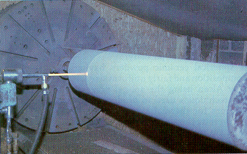
HVOF Spray vs. Hard Chromium
Additional Limitations:
High Equipment Cost
Requires blasting of parts
Intense UV light
Dust & Fumes
Baghouse Required
Constant Distance Requirement
Robotics Required
Limited to parts with simple geometries
Surface Preparation:
Degrease
Blast Finish
Alumina
Silicon carbide

Slide 5
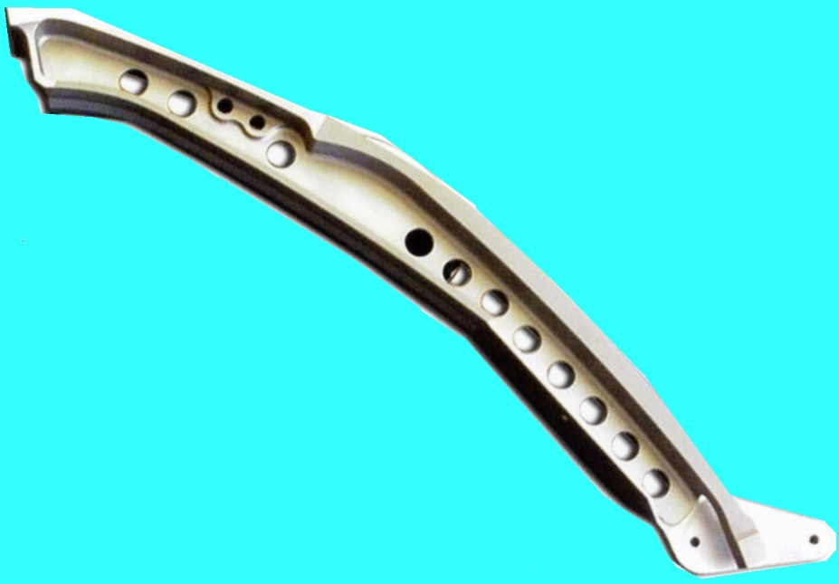
HVOF vs. Hard Chromium
Adhesion
Bond strength of chrome plate = ~ 9,000 psi
Bond strength of HVOF coatings = >>10,000 psi
Wear
HVOF coatings (WC-Co) = 4-5 X Better
Corrosion Protection
Hard Chrome plate
Good salt spray resistance
Poor crevice corrosion resistance
HVOF Coatings
Good salt spray resistance
Excellent crevice corrosion resistance
Mechanical Properties
Hard Chrome plate
Normally tensile stressed
More prone to cracking/fatigue failure
HVOF
Normally compressive stressed
Less prone to cracking/fatigue failure
MD-80 Slat Track
HVOF Sprayed on Roller Surfaces
Photo by F. Altmayer

Slide 6
HVOF Spray Properties vs. Hard Chrome
Fatigue:
Hard Chrome:
Lowers fatigue strength (4340 steel)
HVOF Coatings:
Lowers fatigue strength but to a lesser degree than chrome
At elevated cycles some coatings enhance fatigue strength
Hydraulic Cylinder Leakage:
Significantly lower level of leakage for HVOF vs. Hard Chromium
Drops
Cycles

Slide 7
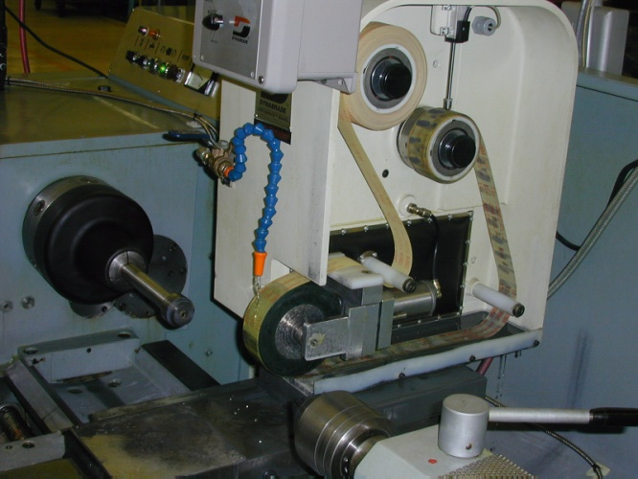
Polishing & Stripping HVOF Coatings
Polishing:
Must use diamond based abrasives
Requires superfinish to remove debris
Small Level of surface porosity remains
Stripping:
Reverse current in Rochelle salt solution
Resistant to water jet stripping
Some coatings on some parts (T400 vanes for example) are nearly impossible to chemically strip
High capacity rectifier required
Superfinish Polishing
Stripping Process:
Na₂CO₃ 20-30g/L
Rochelle salt 8-12g/L
Temperature 104-150°F
pH 11-12
Volts 4-6
CD 4-8 ASI
Photo by F. Altmayer

Slide 8
Physical Vapor Deposition (PVD)
Definition:
A group of surface coating technologies used for decorative coating, tool coating, and other substrate coating applications
Basic PVD Deposition:
A vacuum environment process employing atom by atom transfer of material from the solid phase to the vapor phase and back to the solid phase, gradually building a film on the surface to be coated
Reactive PVD Deposition:
Depositing material reacts with a gaseous back-filled into the vacuum chamber to produce a compound coating, such as a nitride, oxide, carbide or carbonitride.
Vapor Phase
Solid Phase
Basic PVD
Reactive PVD
Gas
+

Slide 9
Physical Vapor Deposition (PVD)
Advantages:
Compatible with many metals and plastics
Can produce harder coatings than can be applied by electroplating
Can produce alloys that cannot be produced by any other method
Few limits on type of inorganic coatings applied
“Dry” process (eco-friendly)
TiN
Photo from Wikipedia

Slide 10
Physical Vapor Deposition (PVD)
Disadvantages:
Parts may be exposed to high temperatures
Not usually good choices for parts such as fasteners
Line-of-sight processes
May require special training by operating personnel.
Trial & error to determine best PVD technology for given application
High capital costs (near clean room environment required)
Parts typically require electroplated layers for maximum corrosion protection
TiCN
Photo from Wikipedia

Slide 11
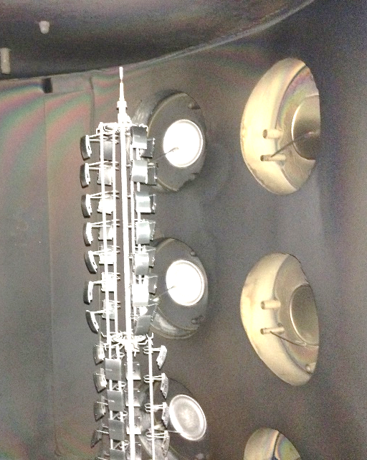
Sputter Ion Plating
AKA: Ion assisted deposition (IAD), ion vapor deposition (IVD)
Specimens and source material are placed in a vacuum chamber back-filled with an inert (Ar) or reactive gas (NH₄, CO)
A low-voltage arc + heat evaporates a portion of the source material
Coating is formed by bombardment of specimens with accelerated target particles
Films having good adhesion, fine microstructure, and high density are possible
Typical thickness = 10 - 30 microns
Deposition rate = (0.000001-0.000006”/minute
Photo and illustration by F. Altmayer

Slide 12
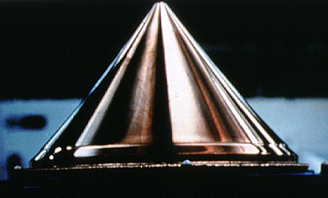
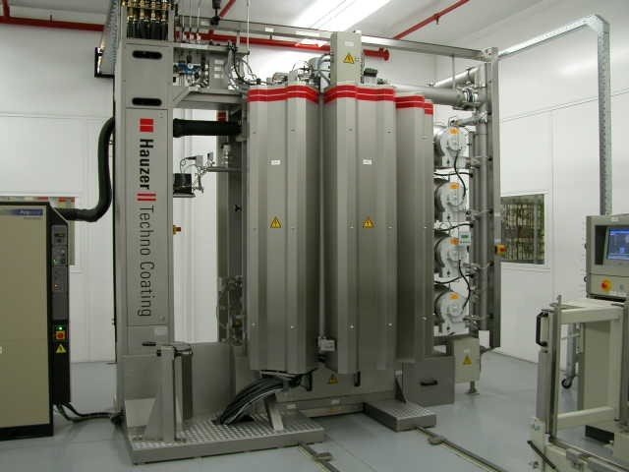
Sputter-Ion Plating
Features:
Precise Control Over Compositions
Ability to Deposit Thick Multilayers
Variety of Deposited Coatings
Low Thermal Loading
Deposit is Free of “Droplets”
Ability to Automate
Environmentally “Friendly”
In-situ Sputter Cleaning
Better Coverage/Uniformity
Coating Properties Not Related to Incidence Angle of ions
Coating Properties Can Be Manipulated
Better Adhesion
Finer Microstructure
Less Porosity
Ion plated copper on
molybdenum mirror surface
The deposition rate = 5 - 30 angstroms/sec.

Slide 13
Sputter-Ion Plating
Computer Controlled:
Timing
Gas Pressures
Temperatures
Factors Affecting Color:
Mass Density
Partial pressures of reactive gases
Evaporation Rate
Temperature
Target material -- Purity
Out gassing of substrate
Contaminants
Disadvantages:
Many Variables to Control
Difficulty in Obtaining Uniform Bombardment (line-of-sight)
Excessive Heating of Substrate
Gas Inclusion in Coating
Substrate Irradiation (X-rays)
Electroplated under-layers required
Racking is labor intensive
Part size is limited
Highly stressed deposits at high thickness

Slide 14
Sputter-Ion Plating
Typical Process Flow:
1. Nickel-Chromium Plate
2. Inspect
3. Rack
4. Clean
5. Dry
6. Load into PVD chamber
7. Pump down
8. Plasma cleaning
9. Deposition
10. Vent chamber
11. Unload
12. Un-rack
13. Inspect
14. Package for shipment

Slide 15
Ion Implantation
In a vacuum chamber (10⁻⁵ Torr), ions are accelerated in an electrical field and directed to a target surface
Ions strike the surface of the target with kinetic energies 4–5X greater than the binding energy of the atoms in the target
Physical and chemical structure of the surface is altered
Penetration depth is typically about 0.1 micron
Ions implanted include Ag, Al, Ar, As, B, Be, C, Ca, Cl, Co, Cu, F, Fe, Ge, H, He, K, Kr, Li, Mg, Mn, N, Na, Ni, O, P, Re, S, Si, Sb, Ti, V, Y, Zn
Targets may be made of metals, alloys, semiconductors, ceramics, glass and plastics
Surface Roughening
Reflected Ions
Ion Beam
Sputtered Atoms
Implanted Ions

Slide 16
Ion Implantation
Advantages:
Environmentally “friendly”
Modified surfaces may offer better wear, lower coefficient of friction, and more corrosion resistance vs. hard chromium
Low operating costs ($100-1000/m²)
Substrate subjected to low process temperature (<150°C)
No Hazardous gases, liquids, effluents
Surface Roughening
Reflected Ions
Ion Beam
Sputtered Atoms
Implanted Ions

Slide 17
Ion Implantation
Disadvantages:
Capital intensive ($500,000 minimum)
Lots of trial error on dosage and energy level for best results
Highly trained personnel required
Crystal structure of the target can be damaged or destroyed
Line of sight process (to 45°)
After service, worn surface may be especially difficult to refurbish
Electrocution hazard
Radiation hazard
Targets are subjected to heat during implantation
Surface Roughening
Reflected Ions
Ion Beam
Sputtered Atoms
Implanted Ions

Slide 18
Electroplated Tin-Cobalt for hexavalent/trivalent chromium
Substitution
Non-chromium alternative to decorative chromium plating
Applied over bright nickel
Appearance identical to decorative chromium
Excellent covering power
Does not provide significant wear or corrosion resistance
A 2 minute soak in 3.5 g/L chromic acid at 60-70°C can increase the level of corrosion protection
Solutions are proprietary
Formulations and alloys produced will vary
Example formulation:
Composition* (g/L)
Cobalt salt 40
Tin salt 5
Conductivity salt 5-10
22%Sn-78%Co Deposit
*Courtesy of MacDermid-Enthone Inc.
Photo by F. Altmayer

Slide 19
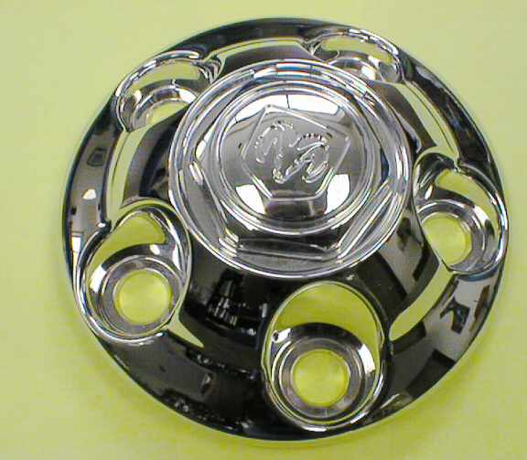
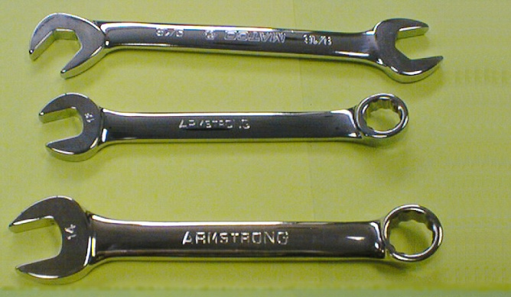
Electroplated Tin-Cobalt for hexavalent/trivalent chromium
Substitution
Operating Conditions:
pH 7.8-8.5
CCD rack 0.3-0.5A/dm² @6-8V
CCD barrel 0.1-0.2A/dm² @12-15V
Temperature 40-50°C (104-122°F)
Temp Max: 60°C (140°F)
Anodes 304/316 stainless
Agitation Mechanical (No air)
Filtration 1 micron/carbon
Important Contaminants:
Copper dark in LCD @ >50ppm
Nickel dark deposits @>300ppm
Sn⁺⁴ dark deposit @>3,000ppm
Properties:
Thickness 0.2-1.0µm
Hardness HV₁₀₀ 400- 450
Which wrench is Sn-Co plated?
Photos by F. Altmayer

Slide 20
Copper-Tin-Zinc for Nickel
Substitution
Known as White Bronze, Bright Alloy, Albaloy®, Miralloy®, Optaloy ®
Cu (55-60%)-Sn (25-28%)-Zn (14-18)
Features:
Bright
Solderable
Hardness > nickel (up to 600HK₂₅)
Non magnetic
Effective diffusion barrier between gold and copper
More abrasion resistant than nickel
35% the conductivity of copper
Spring loaded washers for electronic terminals, bright alloy plated
Photo by F. Altmayer

Slide 21
Copper-Tin-Zinc for Nickel
Substitution
Drawbacks:
Plating solution contains cyanide
Solution chemistry & alloy composition are very difficult to control
Higher operating temperature
Frequent carbonate removal is required
Solution (g/L):
Copper Cyanide 3.25
Zinc cyanide 2.0
Sodium stannate 1.65
NaCN 22.5
Na₂CO₃ 30
NaOH 4.5
Brightener As req.
Operating Conditions:
pH 12.6-13.0
NaCN^{F} (g/L) 2.5-3.0
Volts (barrel) 5-6
Volts (rack) 3.5-4.5
CCD (rack) 15-20
Temp. (rack) 60-65°C
Temp. (barrel) 65-70°C
Anodes 55/30/15 Alloy with 75% of area Steel
Note: pyrophosphate based process (US 9263609 B2) and MSA based solutions are also available

Slide 22
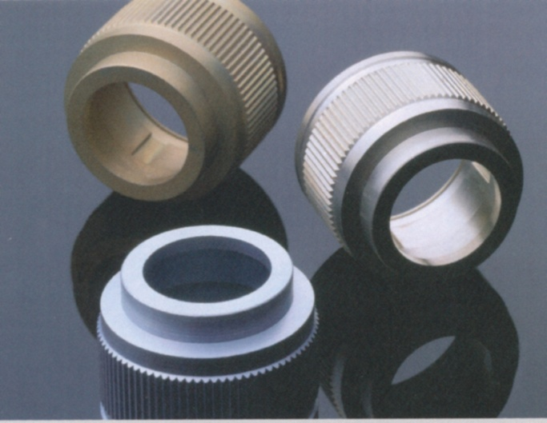
Substitution
Cr⁺³ Chem Film for Cr⁺⁶ Chem Film
Developed by US Navy
Mixture of Cr⁺³ salts and metallic fluorides
Solution operates in a steady-state condition
Coating weights of 20-25 mg/ft²
7-15 g/L, pH 3.5 – 4.0, 18-50°C, 3-5 minutes
Stand-alone or paint base
Coating
Top: Aluminsecent® (Luster-on), photo by F. Altmayer
Bottom: Interlox ® (Atotech), photo courtesy of Atotech USA
Not Shown: MacDermid-Enthone Iridite ® 400

Slide 23
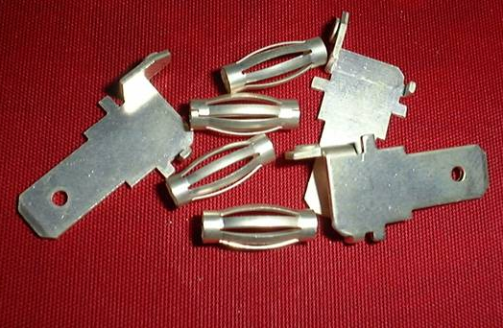
Substitution
Neutral non-cyanide silver for alkaline cyanide silver
Commercialized Types:
Alkaline succinimide
Alkaline methane sulfonic
Advantages:
Harder (120-130HK₂₅), more wear resistant vs. cyanide deposits
Avoidance of cyanide
Possible Drawbacks:
The deposits from some solutions may have a yellow cast, especially at low current densities
Not amenable to high speed (reel-reel) plating due to low current densities employed
Some solutions require copper strike over nickel based alloys
Incorporation of organics may produce blow-holes during soldering
More stressed and prone to rapidly tarnish
Complex chemical make-up makes control of some solutions difficult

Slide 24
Substitution
Neutral non-cyanide silver for alkaline cyanide silver
Solution Make-up Concentration
Silver Ions
(complexed with 5,5-dimethylhydantoin, C₅H₈N₂O₂ ) 25 g/L
Sulfamic acid (NH₂SO₃H) 52 g/L
Potassium hydroxide (KOH) 60 g/L
2,2’-dipyridyl (C₁₀H₈N₂O₂ ) 0.8 g/L
Operating Conditions:
pH 7.5-9.0
Temperature, °C 10-38
Current Density 0.2-2.0 A/dm²
Anodes Pure Silver or inert
Anode/cathode ratio 1:1 to 5:1
Anode current efficiency 70-90%
Cathode current efficiency 85-98%
US Pat. 10,785,297, 2004 *granted to Technic Inc.

Slide 25
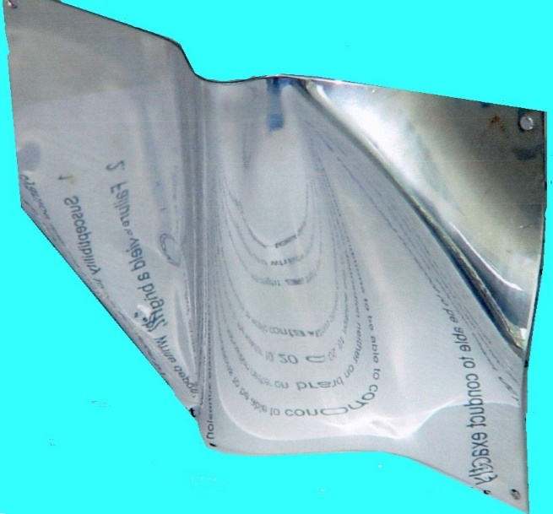
Substitution
Neutral non-cyanide silver for alkaline cyanide silver
Solution Make-up Concentration
Silver Ions (as AgSO₃CH₃) 10 g/L
Methane sulfonic acid (CH₃SO₃H)
Neutralized with KOH 10-15g/L
Cysteine (HO₂CCH(NH₂)CH₂SH) 5 g/L
Borax (Na₂B₄O₇·10H₂O) 20 g/L
2-nitrophthalic acid (O₂NC₆H₃(CO₂H)₂) 2 g/L
Nicotinic acid amide (aka Vitamin B₃) 25 g/L
Tegotain 485 surfactant 3 mL/L
Brightener (1% solution, sulfone derivative) 0.1 mL/L
Operating Conditions:
pH 9.5-10.5
Temperature, C 25-30
Current Density 0.3-1.0 A/dm²
Anodes Pure Silver
Deposit exhibits excellent color/brightness. Adhesion over brass and bright nickel is excellent
* US Pat. 6620304B1 granted to EAB-Oberflachentechnologie GmbH

Slide 26
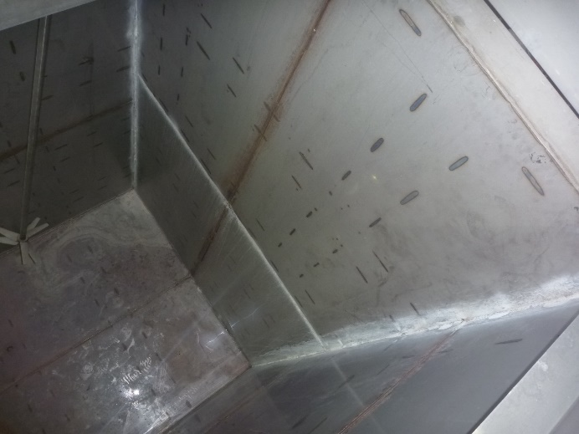
Substitution
Citric Acid Passivation of SS for Nitric/Chromic Acids
Process:
A Citric acid solution is used to remove free iron from thoroughly cleaned stainless steel
Features:
The process replaces more dangerous and environmentally more harmful acids
Free iron is removed from the stainless steel
No fumes/mists generated
There is no measurable dimensional change
Drawbacks:
No oxide film is produced by the process
Oxidation is slowly produced by exposure to air
Some users have reported trouble meeting corrosion resistance requirements
Citric acid poses wastewater treatment issues
“As manufactured” stainless steel tank

Slide 27
Substitution
Citric Acid Passivation of SS for Nitric/Chromic Acids
Process:
Important to Control:
Temperature (within +/-2°F of optimum)
Immersion time (within +/- 10% of optimum)
Chemical composition (within +/-10% of optimum)
The pH of the final rinse (6-8, preferably 6.5-7.5)

Slide 28
The End, Break Time!

