Slide 1
Why Dirt Sticks
Barbara Kanegsberg
BFK Solutions LLC
(310)459-3614
barbara@bfksolutions.com
Surface Finishers Educational Association (SFEA)
February 12, 2015
Orange CA

Slide 2
BFK Solutions Critical Cleaning Consultants, est. 1994
As the industry leaders, we provide
Process improvement, not product sales
Experience, expertise, common sense
Industry involvement: JS3 (military), IPC, ASTM, ISO delegate, EPA, FDA
Barbara Kanegsberg, “The Cleaning Lady”
Biochemist, clinical chemist, manufacturing process
Ed Kanegsberg, “The Rocket Scientist”
Physicist, engineer, process evaluation
“Clean Source” eNewsletter
Free
Sign up!
Editors, 2 volume “Handbook for Critical Cleaning,” CRC Press, 2nd edition, 2011

Slide 3
Always question authority - including BFK Solutions
We make the best effort to provide accurate, up-to-date information
Information, especially quantitative information, is obtained from reliable references
It’s always prudent to reconfirm all technical and regulatory information from the appropriate supplier or regulatory agency
MSDS
Technical data sheet
Most recent requirement or regulation
This presentation contains private and copyrighted material. Not to be distributed without permission of BFK Solutions, LLC

Slide 4
May I have your attention, please!

Slide 5
Overview: Why Dirt Sticks
How cleaning works
Why dirt sticks
How to make dirt “unstick”
Or keep if from sticking
Challenges, finding balance

Slide 6
Cleaning
Cleaning in manufacturing?
Floors
Walls
Windows
Workbenches
Cleanrooms
What about the product?
Manufacturing, repair, rework, restoration

Slide 7
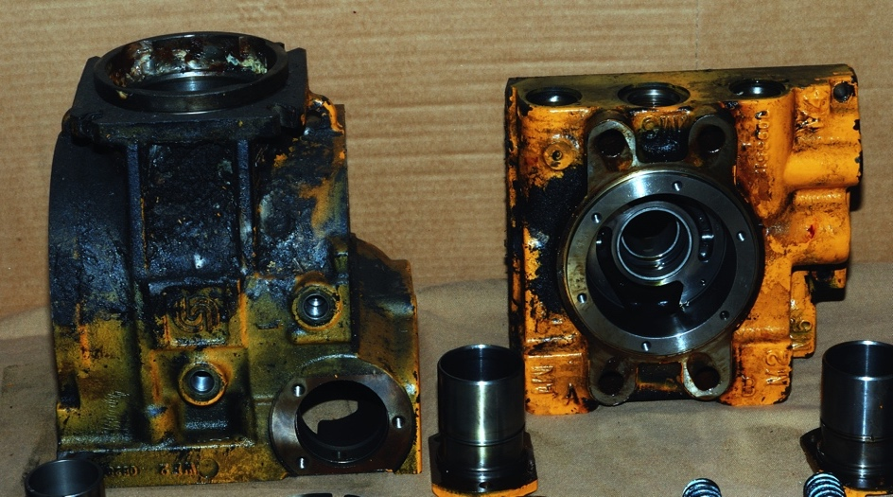
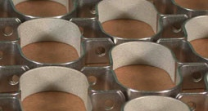

Slide 8
Many (maybe most) manufactured objects need cleaning
Electronics assemblies
Aerospace hardware
Military weapons
Implantable medical devices
Paintings, sculpture
Computer hardware
Coffin corners
Analytical instruments
Mixing chambers, product contact
Optics
Automotive parts
Reflectors prior to vapor deposition
Molded plastic parts
Miniature components
Nano-components
Parts made with 3D printing (additive manufacturing)

Slide 9
What’s a hard surface?
Metals
Plastic
Elastomers
Composites
Glass
3D printed objects
The surface may be below the surface
The entire product may be essentially all surface

Slide 10
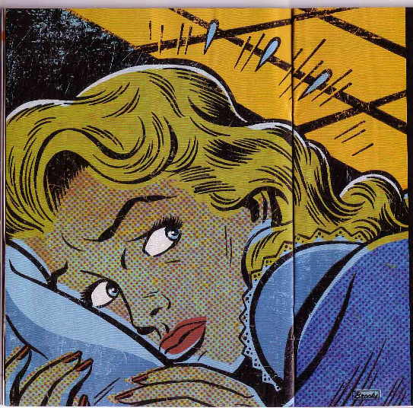
Fears about residue
We SEE THE RESIDUE Our customers detect residue
Our monitoring methods detect residue
Our monitoring methods DON’T detect residue (even worse)
We think we have residue - we’re not sure
The residue sticks – we can’t remove it

Slide 11
Critical Cleaning
Soil
Matter out of place
E.g: burnt on lasagna on a casserole
Cleaning
Removing soil
Critical cleaning - performance
“Tipping point” cleaning
Removing stuff from a product surface that doesn’t belong there
Green cleaning – separate issue, critical cleaning ought to be green
Most manufactured products have to be cleaned to work

Slide 12
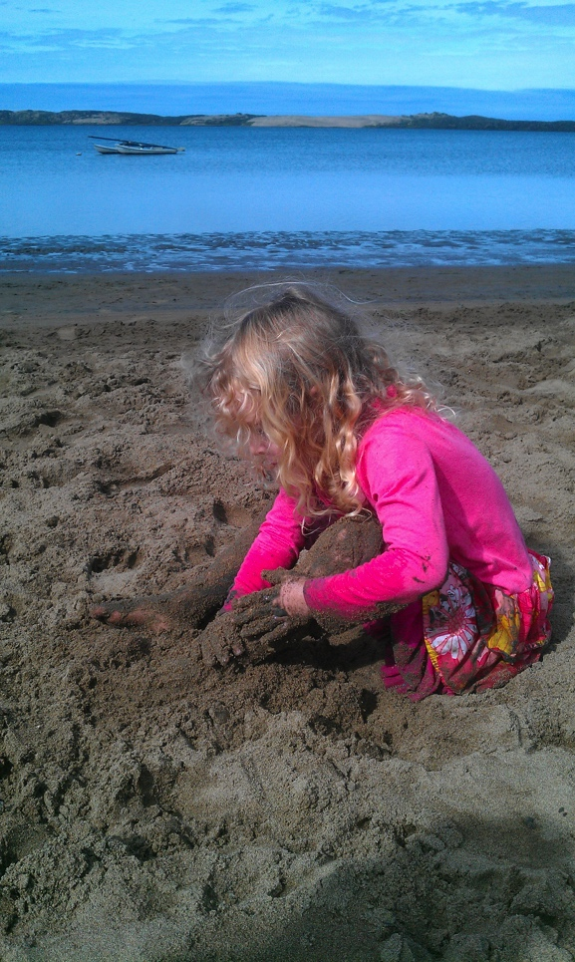
Is it soil? …..

Slide 13
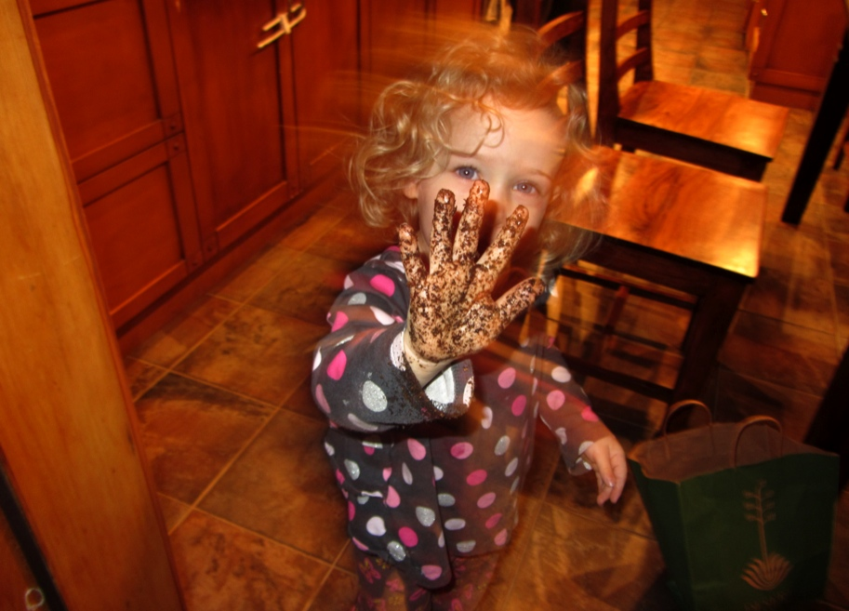
…or is it dirt?

Slide 14
Soils
Solder flux (rosin, organic acid, low residue)
Oils, greases
Metal working fluids
Lapping, polishing compounds compounds
Particles (metal fines, chips, skin flakes, polishing grit, 3D powder)
Acids
Water
Solvent
Product Assortment
Residual product/breakdown (in processing equipment)
Deposited cleaning agent residue (including flux residue)
Rust-preventative
Bacteria, mold, life-forms (alive or dead)
Sterilizing chemicals or processes

Slide 15
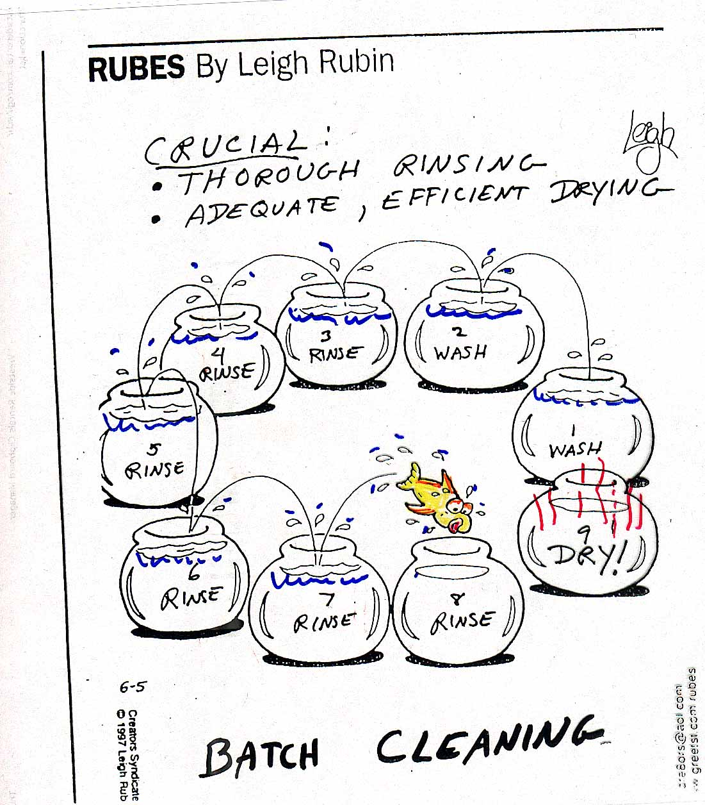

Slide 16
Steps & Functions of Cleaning System: Think About Cleaning Agent and Cleaning Process Together
(1) Wash
Deliver cleaning agent to surface
Provide cleaning action to remove soil without damage to surface
Remove soils from proximity of surface (i.e. leave a clean surface)
(2) Rinse
Remove residual cleaning agent
Continue cleaning process
Vapor degreasing solvent – self-rinse
(3) Dry
Remove water, adsorbed solvent
Separate, distinguishable operations
Allocate $$$ and design time appropriately
Restore cleaning agent for subsequent operation (Optional, but often desirable)
All steps: avoid product damage

Slide 17
Cleaning is a Process
Cleaning chemistry
Force
Temperature
Rule of thumb
10 degree Centigrade increase in temperature doubles reaction rate
Time
Wash, rinse, dry
Cleaning process influences
Worker safety, chemical emissions
Why dirt sticks

Slide 18
Cleaning factors interac – e.g. temperature and solvency
KB number
Kauri-Butanol number
Higher number - > more aggressive solvent
Does not work for oxygenated solvents
Water
Ketones (eg. acetone)

Slide 19
Higher boiling point may help with less aggressive solvents
Cleaning Agent | KB Number | Boiling Point deg C.
Methylene chloride | 136 | 40
Trans-1,2-dichloroethylene | 117 | 47
HCFC-225 | 31 | 54
HFE-7100 | 10 | 61
n-Propyl bromide (nPB) | 125 | 71
Trichloroethylene | 129 | 87
Perchloroethylene | 90 | 121
d-limonene (eg. Citrasolv) | 76 | 178
Stoddard Solvent | 33 | 188
Methyl soyate | 61 | 315

Slide 20
Overview: Why Dirt Sticks
How cleaning works
Why dirt sticks
How to make dirt “unstick”
Or keep it from sticking
Challenges, finding balance

Slide 21
Sometimes, you just know you’ll have cleaning problems

Slide 22
What makes soil difficult to remove?
Manufacturing processes can impede cleaning
Soil
Force
Heat
Time
Product shape and material
Changes in regulations
Environmental, safety

Slide 23
A balancing act
What helps remove soil?
What makes soil stick?
Forces
Cleaning chemistry
Temperature
Time
Forces
Soil chemistry and size
Temperature
Time
Product shape and material
Changes in regulations
Limits available options

Slide 24
Balancing forces
What helps remove soil?
What makes soil stick?
Chemical force
Polar/dispersion
Physical force
Impingement
Agitation
Must obtain access to surface with soil
Chemical force
Polar/dispersion
Physical force
drive particles into substrate (plastic, glass, metal)
Cleaning/Drying/Polishing

Slide 25
Balancing chemicals and soils
What helps remove soil?
What impedes removal?
Type of cleaning agent
Aqueous/organic solvent
Solvency
Wetting/penetration
Rinsing
Drying
Type of cleaning agent
Polar/non-polar
Chemical nature of soil
Silicone
proteins
Particle size
Small particles adhere
Dried soils
Crevices/holes

Slide 26
Balancing temperature
What helps remove soil?
What makes soil stick?
Higher temperatures
More vigorous agitation
Melting, vaporization
Lower viscosity
Higher temperatures
Caramelization
Flash drying
Baked on soils
Substrate change

Slide 28
Balancing time
What helps remove soil?
What helps soil stick?
More time → more cleaning
Prompt cleaning
More time → more damage
Latency (prior to cleaning)
Longer soil adheres, the harder it adheres

Slide 29
Dispersion forces
Symmetric molecule induces dipole
http://itl.chem.ufl.edu/2045/lectures/lec_g.html

Slide 30
Van der Waal’s Equation

Slide 31
Why do dried soils and small particles stick?

Slide 32
Gecko feet
Geckos can adhere to a “smooth” dry surface
No sticky fluids exuded
Thousands/millions of tiny hairs (cilia); each hair has a tiny spatula foot
Foot provides surface area (many molecules) for dispersive attraction
Microscopic dimension allows foot to fit into small surface irregularities
Small particles are like gecko feet
Dried soils are like gecko feet

Slide 33
What manufacturers need in cleaning solvent – actual request by presenter at major workshop
No ODP, No HAP
Low/no VOC, GWP
Not toxic to workers
Non-flammable
Non-halogenated
No formulation variability
Non-aqueous
Evaporates with no residue
Low cost
Use in current cleaning equipment
No employee retraining
Low to no capital costs
Does not damage part
No/low rinse
Rapid drying
Do a TERRIFIC JOB of cleaning

Slide 34
Presenter’s request to cleaning agent suppliers: Think outside the box
Barb’s response:
You want them to think outside the periodic table of the elements

Slide 35
Issues hampering new cleaning agent development
Technical constraints (physical/chemical)
Think Outside the Box versus Outside the Periodic Table
Market fragmentation
Miniaturization, tight spacing
Diversity, materials of construction
Development costs
Very high
Cleaning a small market segment
Regulatory requirements
Increasing difficulty for approval

Slide 36
Issues hampering new chemical development
Political chemistry
Negative lobbying by chemical companies against competition
To manufacturers
To governmental agencies
Corporate environmental policy
Global
Draconian
Eg: No halogens allowed - Acetone is ok!

Slide 37
Newer cleaning chemistries tend to be less aggressive
Avoiding air toxics
VOCs vs ODCs
If it doesn’t impact the stratosphere, it impacts the troposphere
There are many lists of chemicals to avoid
Geographical specificity
Government sponsored
Company policy constraints
Smaller companies, job shops
May have few effective choices, may impact performance
They may assume LARGER, FINAL FABRICATORS will do the major cleaning

Slide 38
“Biofeedback” loops – California pressure

Slide 39
Examples - biofeedback
Lubricants reformulated nationally to achieve lower VOC levels
ILMA/SCAQMD collaboration
Thermogravimetric analysis
Net result: higher boiling points, more residue
Ozone Transport Commission Regional Model rules
Degreasing model rule a “cut and paste” of SCAQMD regs
Very low VOC content

Slide 40
Manufacturing issues, biobased cleaners
Unestablished toxicity
Residue on product
Product stability
Breakdown of esters
Batch to batch consistency
Flammability
High boiling point
VOC

Slide 41
Overview: Why Dirt Sticks
How cleaning works
Why dirt sticks
How to make dirt “unstick”
Or keep it from sticking in the first place
Challenges, finding balance

Slide 42
Know your product – product configuration
Know the consequences of configuration
Blind holes, helicoils, tight spacing
Miniaturization
Additive manufacturing
Redesign product – if possible

Slide 43
Know your product – materials of construction
Materials compatibility problems of “delicate” materials limits aggressiveness of cleaning process
Light metals (eg. Al, Be)
Composites
Plastics – batch to batch variability
High porosity materials
Adsorb soils or solvents
Plan the cleaning process to avoid the problem

Slide 44
Avoid the problem in the first place
New products – control the euphoria of your designers
Educate the designers
Teach them about critical cleaning/surface quality
Encourage (coerce) them to talk to the techs
Require them to assemble, clean, and coat their own product!

Slide 45
Understand the soils
What are the residues?
Organic, inorganic, salts, biologics
Thin film, particle, adsorbed gas
Switch to a less adherent soil if possible
The process modifies the soil, makes them tougher to remove
“water-soluble” lubes, newer metalworking fluids
“water-soluble” fluxes
Keep an eye out for regulatory changes

Slide 46
Understand the cleaning process – cleaning chemicals
Know what the cleaning agent is
Aqueous
Solvent (organic)
Soils it dissolves well, soils it dissolves poorly
Oils
Greases
Mixed soils
Particles

Slide 47
Clean the part right away
Clean immediately
Clean later? Usually more cleaning
Temperature, time changes soils
Store parts in a cleanroom bag?
Won’t help if the parts are dirty
Shipped parts – harder to clean
More time, temperature excursions

Slide 48
Manage the supply chain
Make cleaning process a collaborative decision
Specify cleaning in the contract
Immediate cleaning
Make sure suppliers use a cleaning process that works
Audit periodically
Cheap, generic suppliers – may cost more in the long run

Slide 49
Are you part of the supply chain?
Understand how the parts you supply are used
Where could leftover dirt be a problem?
Anticipate your customer’s problems with soils
Become the cleaning solution for your customers
Tactfully educate your customers

Slide 50
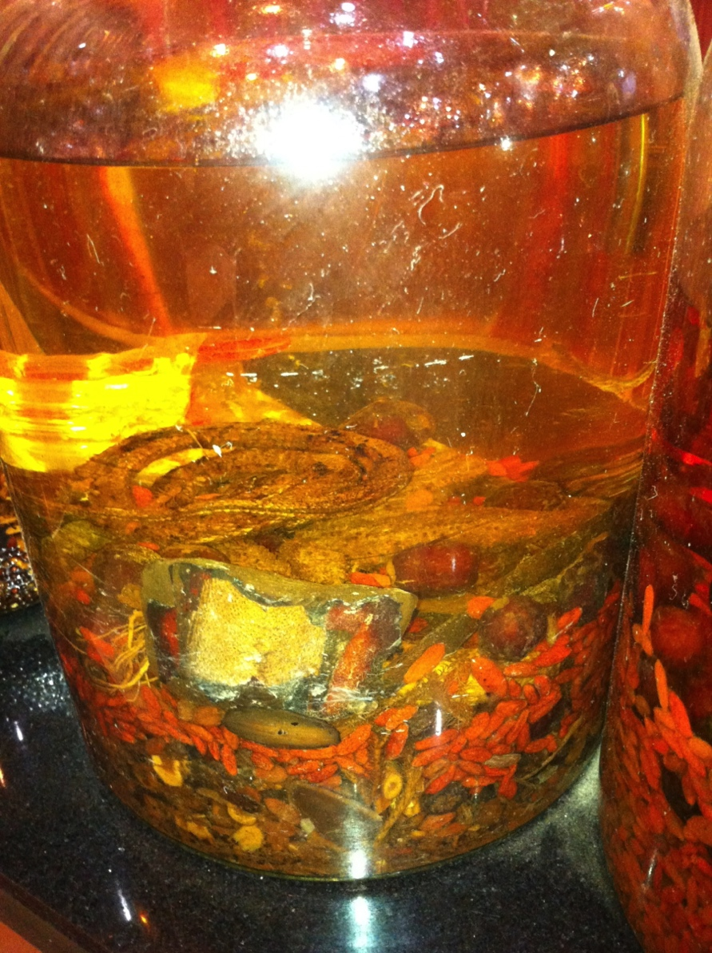
Cleaning chemistries are not snake oil! (usually)

Slide 51
Hansen parameters: Absolute numbers & balance influence solvency
Compound | Non-polar (dispersive) | Polar | Hydrogen bonding
Perchloroethylene | 19.0 | 6.5 | 2.9
n-propyl bromide | 16.0 | 6.5 | 4.7
HFC 43-10mee (Vertrel™) | 12.9 | 4.5 | 5.3
HFE 7100 (Novec™) | 13.7 | 2.3 | 1.3
Trans-1233zd (Solstice™) | 15.5 | 4.5 | 2.2
Water | 8.6 | 13.4 | 25.8
Isopropyl alcohol | 15.8 | 6.1 | 16.4
Acetone | 15.5 | 10.5 | 7.0

Slide 52
Solvency parameters – like paint chips

Slide 53
Select the cleaning process carefully
Is it really removing the soils?
Are adherent soils likely to increase in newer products?

Slide 54
Example – great expectations
Final assembler
Cleaning glass
Cleaning assorted metals
including aluminum

Slide 55
Unrealistic Expectations
Wants to “improve” supply chain
More suppliers
Less costly suppliers
Expects to use two cleaning systems
Metals
Glass
Some problems
Inconsistent soils
Dry soils

Slide 56
Are you seeing a increase in soils that stick? - Monitor & Re-evaluate
Be aware of changes
Monitor the process
Cleaning agents
Water quality
Surface quality
Residue
Be on the lookout for changes
In soils
In cleaning agent formulations or availability

Slide 57
Overview: Why Dirt Sticks
How cleaning works
Why dirt sticks
How to make dirt “unstick”
Or keep it from sticking
Challenges, finding balance

Slide 58
Desirable, beneficial contamination
Surface cleaning may impart desirable changes
Stents – people lived because of contamination
R. Baier
Interaction, polishing compound, heat, metal
Non-thrombogenic surface
Is the process leaving a desirable residue?
Rust preventative
Primer
Strike

Slide 59
More surface area - > more cleaning
Soil – inevitable in manufacturing
Harder to clean
Large surface area
“hidden” or inaccessible surface area
Surface area relative to mass is increasing
Micro components
Nano components
Products produced via additive manufacturing

Slide 60
Additive manufacturing-3D Printing
Allows designs of product or equipment with complex surfaces
Intricate shapes
Internal cavities
Individualized (“one-off”) products
Fascinating cleaning challenges

Slide 61
Additive (3D) Cleaning Challenges

Slide 62
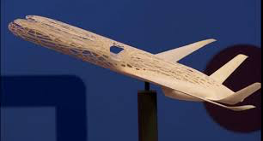

Slide 63
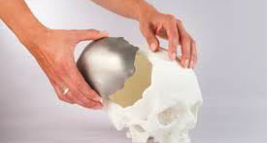

Slide 64
Example – 3D Challenge - Particles
People worry about particles
Military & ISO specs
General rules
The more you clean, the more particles you remove
If you change cleaning agents, you remove different populations of particles
Eventually, cleaning erodes the surface
Existing products - we meet the rules
Additive
Complex surfaces
we haven’t written the rules
Needed: pragmatic decision on allowable particle levels

Slide 65
Additive Manufacturing- Soil that sticks
Raw material (powder) residue
Cleaning, rinsing and drying internal areas
Unexpected residue
New, exciting alloys, alloy gradients
Surface prep & coating challenges
Medical devices
Comments by FDA person, MD&M (Feb, 2015)
Would like to adopt additive
Sees cleaning, particles as major issues

Slide 66
TANSTAAFL (“There ain’t no such thing as a free lunch”) Robert Heinlein, “The Moon is a Harsh Mistress”
Better solvency desired
If it dissolves the soil, it MAY damage the product
Everyone wants a universal solvent
How would you store it?
Safety, low environmental impact desired
If a cleaning agent dissolves the soil
it can impact you
Our products depend on organic chemicals (metalworking fluids)
We’re made of organic chemicals
It can impact the environment

Slide 67
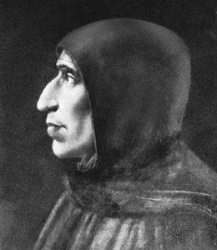
Is there a ‘perfectly safe’ chemical?
Let’s ask
Cosimo de’ Medici

Slide 68
Where did the de Medici’s get their poisons?

Slide 69
From the garden, perhaps …
Treat all chemicals responsibly

Slide 70
Cleaning: A never-ending balancing act

Slide 71
“TANSTAAFL” - Cleaning, Surface Finishing
Cleaner is better?
We want cleaner surfaces
More cleaning, more problems
High temperature, more adherent soils
Surface damage (materials compatibility)
May remove beneficial contamination

Slide 72
It’s a matter of finding balance
Find the optimum process to remove the soil
without harming the worker
without harming the environment
without harming their pocketbook
Without harming the product itself

Slide 73
Questions? (310-459-3614 barbara@bfksolutions.com)

