Slide 1
Overview of Process Lines
Automated side arm Console; orthopedic implants
Automated side arm E-Coat Line; mintage
Automated side arm Phosphate Line; automotive
Automated ½-ton Zinc + Chromates; job shop
Automated 2-ton pantograph Pickle Line; titanium
Manual 7½-ton gantry Pickle Line; steel wire
Automated 7½-ton gantry Pickle Line; steel wire
Automated 10-ton crane Chemical Etch Line; titanium

Slide 2
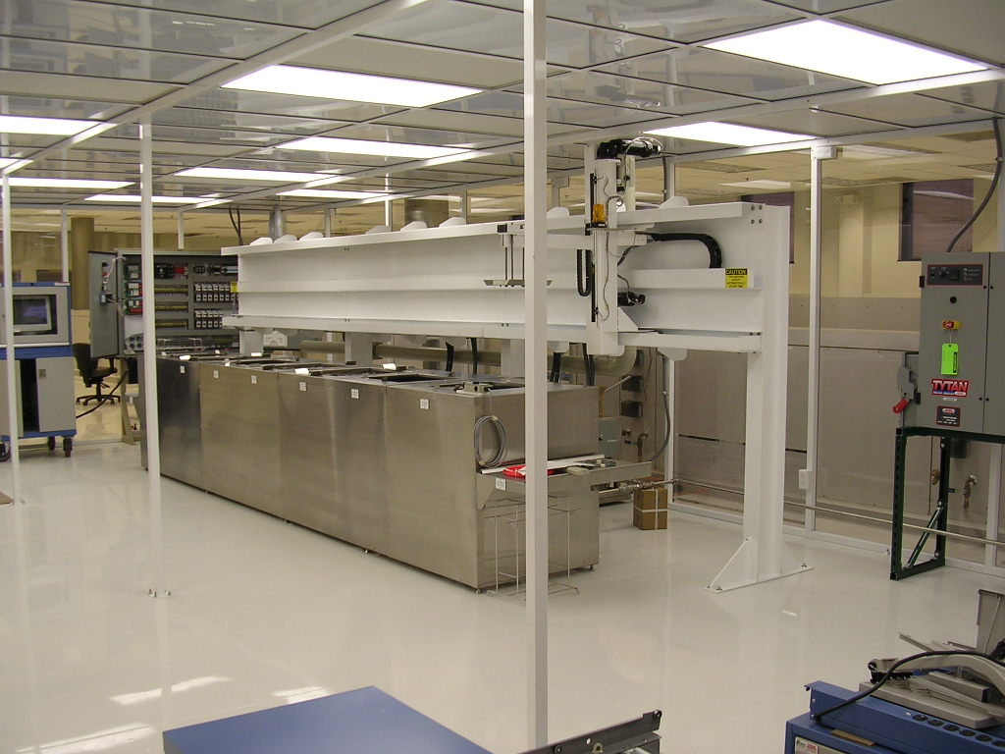
Automated side arm Console; orthopedic implants

Slide 3
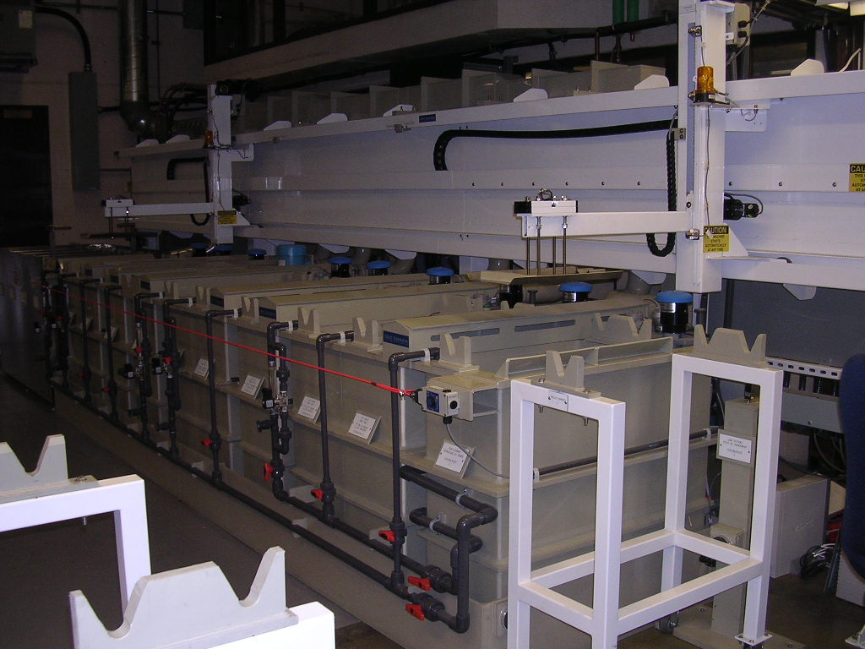
Automated side arm E-Coat Line; mintage

Slide 4
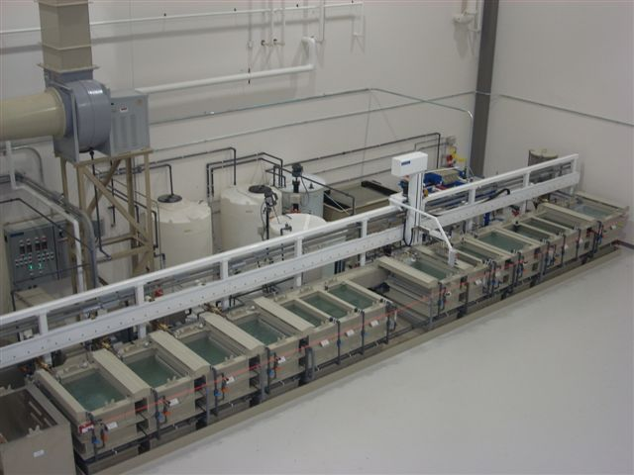
Automated side arm Phosphate Line; automotive

Slide 5
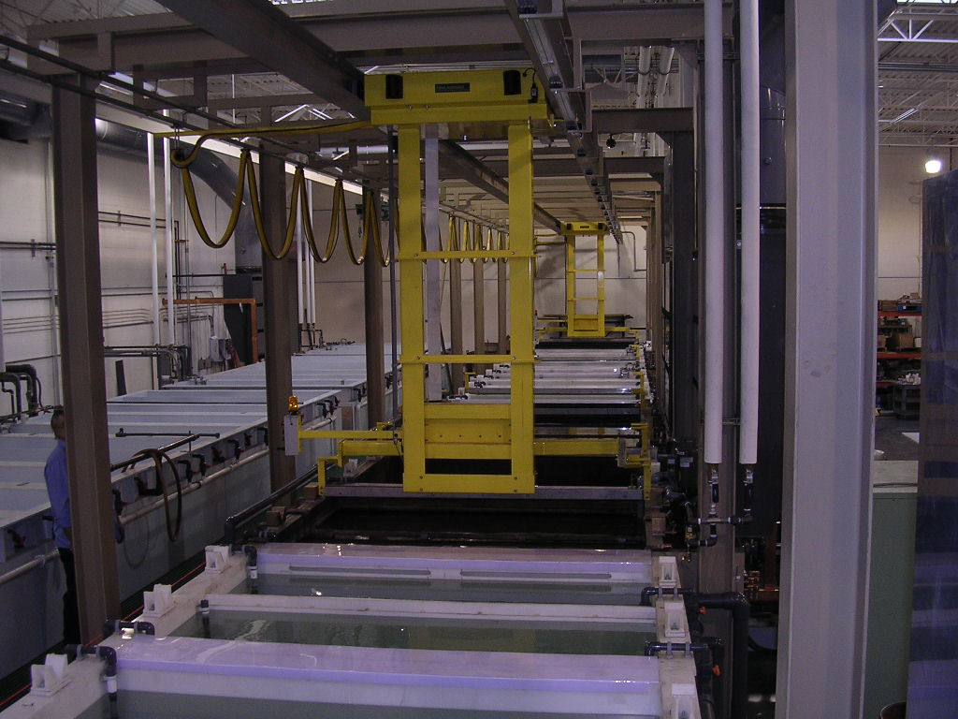
Automated ½-ton Zinc + Chromates; job shop

Slide 6
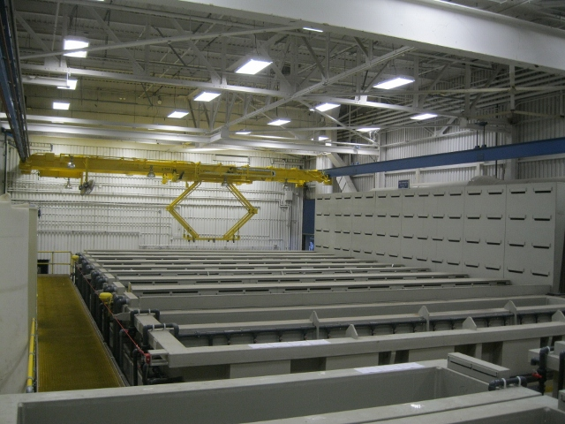
Automated 2-ton titanium pickle Y-config.

Slide 7
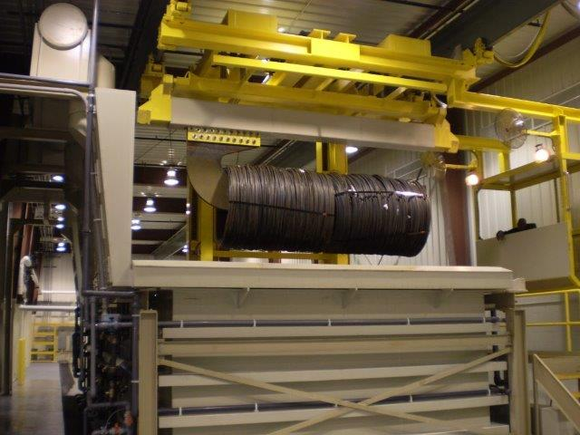
Manual 7½-ton gantry Pickle Line; steel wire

Slide 8
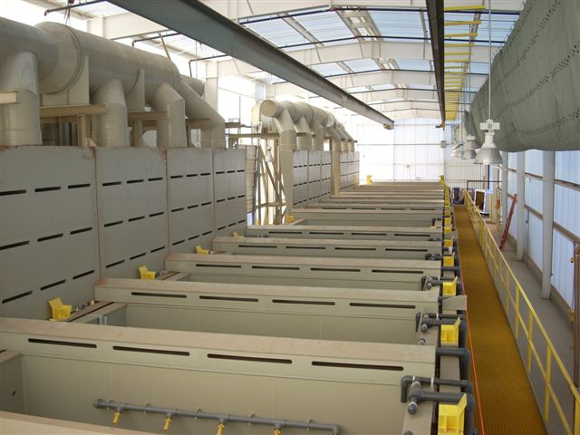
Automated 7½-gantry Pickle Line; steel wire

Slide 9
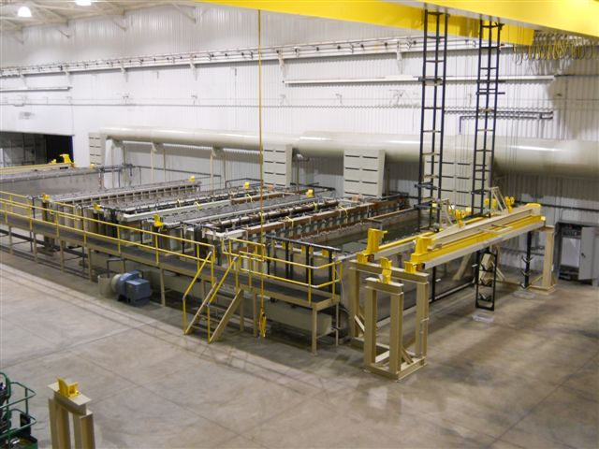
Automated 10-ton crane Chemical Etch Line; titanium

Slide 10
Process Line Morphology:
Tank lines versus Consoles
Enclosures versus Ventilation systems
Polypropylene versus stainless /carbon steel lined
Homo polymer versus European Grey co-polymer
Containment: berm /pan versus pit
Scrubber: at grade versus roof
Wastewater Treatment: at grade versus mezzanine
Circulation around the line: minimum of 4ft clear
Notes:
Chemical compatibility - longevity – elasticity - repairability -

Slide 11
Material Handling
Gantry: structure, rail type, lifting (wire, chain, belt)
Side arm: cost, moment load, belts, chains, slides
Rimrunner: continuous pinch point, blocked access
T-stroke versus J-stroke
Number of pickup/drop-off points
Positioning Systems: open-loop versus closed-loop
relative absolute
rotary, bar code, infrared, laser
Safety interlocks and e-cord

Slide 12
Fume extraction, Plenums, Ducts, Scrubber, Make-up and Push-Air
Process tanks: surface area, chemistry, temps
Heated rinses: is direct discharge cost effective
Air flow at tanks 2 to 3 fps = ft³/minute for sizing
Side plenum slot velocity 10 to 16 fps (adjustable)
Rear duct velocity 36 to 48 fps to prevent dropout
Make-up air: 90%-95% of extraction; laminar flow
Push-air: only affect front of tanks for operators
Eductors versus air-agitation
Notes:
2 or 3 based on chemistry and temperature

Slide 13
Water optimization
Cascades: 2 or more stages, with halo sprays
Fills: intermittent versus feed rates;rotometers
Rinse reuse within line or for neutralization
recycle and reuse
Notes:
10:1 dilution factor – JM in WA 5x best is solenoid-to-rotometer reuse

Slide 14
Controls
PLC versus PC, hybrid systems (60bpm heartbeat)
PC high level
PLC low level and safety (limitations)
Reservation system versus random loading
ISO and Nadcap documentation and certification
Notes:
cortex/brain stem ±20 barcodes v 14,000

