Slide 1

Conditions Affecting Salt Spray Performance
North America
Europe
By:
Frank Altmayer, MSF, Technical Education Director,
AESF Foundation/NASF

Slide 2

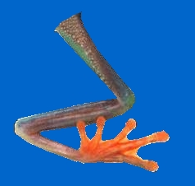
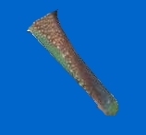



Discovery of the Galvanic Cell
Luigi Galvani is credited with discovery of the galvanic cell in 1780
In reality, Luigi’s WIFE was preparing frog legs on a zinc table
Ouch!
With a steel knife

Slide 3
Corrosion via Galvanic Cells
e
High Impedance
Volt Meter
=
Zn⁺²
=
Zn⁺²
=
Zn⁺²
SO₄⁺²
Salt
Bridge
e
e
=
NI⁺²
++
Cu⁺²
Metal Sulfate
Solution
Reference Cell
SO₄⁺²
SO₄⁺²
Zn—Negative
Ni—Less Negative
Cu—Positive
Notes:
Slide 10
Galvanic Corrosion Theory
When a metal is immersed in a solution containing its own ions, an equilibrium condition between the tendency of the metal to go into solution and the tendency for the metal ions already in solution to deposit is established:
M° = Mn⁺ + ne⁻
If the reaction proceeding to the right is faster than that to the left, the metal surface would be negatively charged. Conversely, if the reaction to the left (the deposition reaction) is faster, then the metal surface would be positively charged. The resulting potential of this interaction between the metal and the ionic solution is called the single potential. When the solution is at unit activity (usually a 1 Molar solution), the equilibrium (single) potential is called the standard electrode potential.
Single electrode potentials are measured using a reference electrode (or half cell), the saturated hydrogen electrode (or other reference electrodes), coupled through a high impedance voltmeter, is used and given the arbitrary value of zero potential.
If a piece of zinc is immersed in a zinc sulfate solution, zinc dissolves, electrons accumulate on the surface, and the metal becomes negatively charged (Eº = -0.76V). Similarly, nickel dissolves, but to a lesser degree and it also becomes negatively charged (Eº = -0.25V). The behavior with copper, however, is quite different. Actually, copper ions are discharged and deposit on the copper. This requires removal of electrons from the copper and results in the copper becoming positively charged when compared with a standard hydrogen electrode (Eº = +0.34V).

Slide 4
Galvanic Corrosion
EMF Series-Sulfate Environment
Standard Potential
Metal E° [volts] at 25°C
Aluminum -1.66
Zinc -0.76
Chromium⁺³ -0.71
Iron⁺⁺ -0.45
Cadmium -0.40
Nickel -0.25
Tin -0.137
Hydrogen ±0.00
Copper⁺⁺ +0.34
Gold +1.68
M⁰ ═ M^{+n} + ne⁻
Active Metals
Noble Metals
Note: In This Series, Cadmium is More Noble Than Iron
Notes:
Shown are the standard potentials as they might be obtained from the testing described on the previous page. It is important to realize that these potential were obtained in a sulfate environment and that they may change if the testing is conducted in other ionic solutions such as chloride (see next page).
The relative rate of corrosive attack on a specific metal vs another metal in a corrosive liquid depends on a number of factors including the relative position of one metal with respect to another in the EMF series shown.
For example, if copper and zinc are immersed in a salt water solution, the zinc dissolves. If copper and gold are immersed in the same solution, copper will dissolve in favor of zinc. This is the basic foundation of galvanic corrosion and galvanic corrosion protection. By electroplating an active metal such as zinc over a less active metal such as iron, the zinc will corrode in favor of the iron, thereby affording sacrificial protection to the iron (the zinc is sacrificed for the benefit of the iron).
If a less active metal is deposited over a more active metal, the coating must be pore free or the corrosive will rapidly attack the substrate. An example is any zinc die casting plated with copper-nickel-chromium.
The greater the voltage difference between the metals, the more rapid galvanic corrosion will be. Note that zinc and iron are only about 0.3 volts apart. If we try to protect iron with aluminum, any pore in the aluminum exposing iron will result in a galvanic cell of about 1.2 volts dissolving the aluminum, and more rapid depletion of the aluminum (vs zinc) will occur.
If a set of metals is studied and potentials are measured, we can chart their comparative behavior, producing the Electromotive Force (EMF) series.
The metals above hydrogen in the EMF series are commonly referred to as active metals, whereas those below hydrogen are called noble metals. The EMF series and Galvanic series are valuable tools for predicting some of the behavior of metals, and for avoiding galvanic corrosion problems.
For example, if we wanted to protect steel (essentially iron) by plating the steel with nickel, the EMF series shows that the nickel must be pore free. If there is a pore in the nickel and a conductive liquid is allowed to travel through the pore and contact both the nickel and the steel, a 0.2 volt battery would be produced. Since the steel in this battery is the “active metal”, it would act as the corroding anode in the battery. Our base metal would therefore not be protected from corrosion by the nickel. Nickel and steel are therefore not a “favorable couple” to avoid galvanic corrosion from occurring.
The closer the potentials between two metals in a given solution, the more favorable the galvanic couple is. Cadmium and iron would be a favorable galvanic couple in a sulfate environment (in which the EMF series was produced), since the potential of the two metals are nearly identical. However, we can not expect cadmium to provide sacrificial protection to steel, since it is slightly more noble than iron in a sulfate environment.

Slide 5
Corrosion via Galvanic Cells
Metal E° [volts], 25°C E in Seawater @ 25°C
Mg → Mg⁺² + 2e⁻ -2.34
Be → Be⁺² + 2e⁻ -1.70
Al → Al⁺³ + 3e⁻ -1.67 -1.1
Zn → Zn⁺² + 2e⁻ -0.761 -1.0
Cr → Cr⁺³ + 3e⁻ -0.710 -0.1
Fe → Fe⁺² + 2e⁻ -0.440 -0.6
Cd → Cd⁺² + 2e⁻ -0.402 -0.7
Co → Co⁺² + 2e⁻ -0.277
Ni → Ni⁺² + 2e⁻ -0.250 -0.15
Sn → Sn⁺² + 2e⁻ -0.136
H₂ → 2H⁺ + 2e⁻ 0.0
Cu → Cu⁺² + 2e⁻ +0.345 -0.4
Ag→ Ag⁺ + e⁻ +0.800 -0.1
Pd → Pd⁺² + 2e⁻ +0.830
Pt → Pt⁺² + 2e⁻ +1.20
Au → Au⁺ + e⁻ +1.68 +.2
Note:
In this series, cadmium is more noble than iron
Note:
In this series, cadmium is less noble than iron
Notes:
Shown are the standard potentials as they might be obtained from the testing described on the previous page. It is important to realize that these potential were obtained in a sulfate environment and that they may change if the testing is conducted in other ionic solutions such as chloride (see next page).
The relative rate of corrosive attack on a specific metal vs another metal in a corrosive liquid depends on a number of factors including the relative position of one metal with respect to another in the EMF series shown.
For example, if copper and zinc are immersed in a salt water solution, the zinc dissolves. If copper and gold are immersed in the same solution, copper will dissolve in favor of zinc. This is the basic foundation of galvanic corrosion and galvanic corrosion protection. By electroplating an active metal such as zinc over a less active metal such as iron, the zinc will corrode in favor of the iron, thereby affording sacrificial protection to the iron (the zinc is sacrificed for the benefit of the iron).
If a less active metal is deposited over a more active metal, the coating must be pore free or the corrosive will rapidly attack the substrate. An example is any zinc die casting plated with copper-nickel-chromium.
The greater the voltage difference between the metals, the more rapid galvanic corrosion will be. Note that zinc and iron are only about 0.3 volts apart. If we try to protect iron with aluminum, any pore in the aluminum exposing iron will result in a galvanic cell of about 1.2 volts dissolving the aluminum, and more rapid depletion of the aluminum (vs zinc) will occur.
If a set of metals is studied and potentials are measured, we can chart their comparative behavior, producing the Electromotive Force (EMF) series.
The metals above hydrogen in the EMF series are commonly referred to as active metals, whereas those below hydrogen are called noble metals. The EMF series and Galvanic series are valuable tools for predicting some of the behavior of metals, and for avoiding galvanic corrosion problems.
For example, if we wanted to protect steel (essentially iron) by plating the steel with nickel, the EMF series shows that the nickel must be pore free. If there is a pore in the nickel and a conductive liquid is allowed to travel through the pore and contact both the nickel and the steel, a 0.2 volt battery would be produced. Since the steel in this battery is the “active metal”, it would act as the corroding anode in the battery. Our base metal would therefore not be protected from corrosion by the nickel. Nickel and steel are therefore not a “favorable couple” to avoid galvanic corrosion from occurring.
The closer the potentials between two metals in a given solution, the more favorable the galvanic couple is. Cadmium and iron would be a favorable galvanic couple in a sulfate environment (in which the EMF series was produced), since the potential of the two metals are nearly identical. However, we can not expect cadmium to provide sacrificial protection to steel, since it is slightly more noble than iron in a sulfate environment.

Slide 6
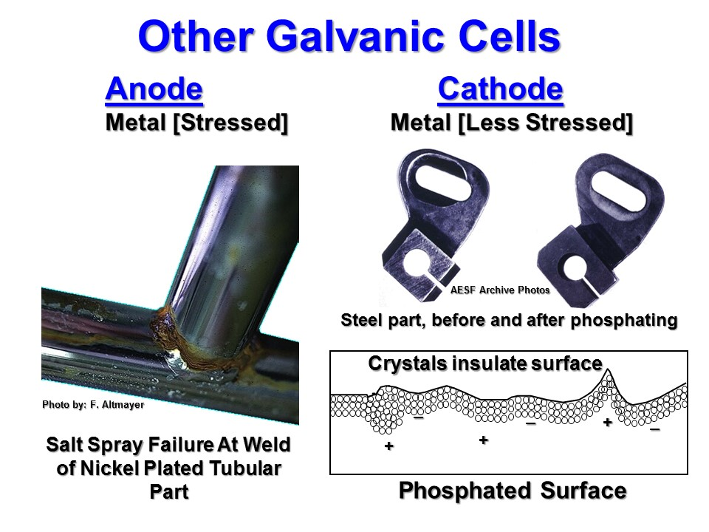
Preventing Bi-metallic Corrosion
Prevention Measures:
Plate with metals of similar electrode potential
Plate a pore free deposit
Eliminate electrolyte by applying barrier film
Eliminate ionic path
Reverse direction of electron flow
Brass
Plastic Foam Pad
Migrated Gel
Silver plated plastic
Silver Chloride Coating
Chloride Gel
Poorly designed ECG electrode
Notes:
Slide 13
Galvanic Cells
Similar to an electroplating cell, a corrosion cell (also known as a galvanic cell or galvanic couple) has basically four items, as shown in the slide. While a widely encountered type of corrosion cell, it should be recognized that bimetallic corrosion couples (galvanic cells) are not the only type of corrosion cell found in the real world of corrosion. The slide describes several other possible corrosion cells.
Metal/Metal Oxide Galvanic Couples
The type of oxide or tarnish film that may develop on a metallic surface has a great deal to do with the rate of corrosive attack of the metal. Generally, if the film that forms has a density less than that of the metal, the film will be porous, thus promoting corrosion of the underlying metal. The oxide of a metal tends to be cathodic to the metal from which it was formed.

Slide 7
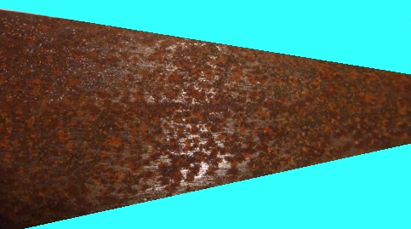
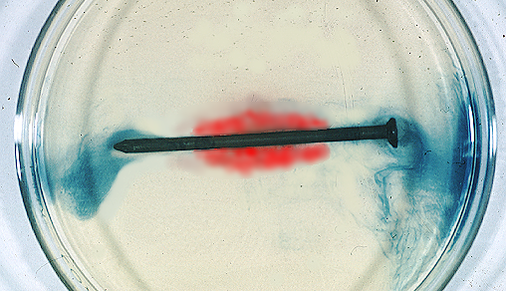
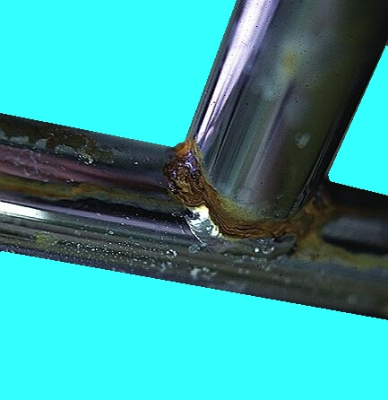
Other Galvanic Cells
Anode Cathode
Metal [Stressed] Metal [Less Stressed]
Anode
Cathode
+
+
Cathode
Cathode
–
–
–
–
+
Stress Anode
Photo by: F. Altmayer
Surface of manufactured metal part
Surface of unprotected polished steel spear after 20 years interior storage
Cathodic Area
Anodic Areas
Salt Spray Failure At Weld of Nickel Plated Tubular Part
Unprotected nail in a corrosive environment
Photo by: F. Altmayer
Un-coated Nail in Corrosive Gelatin
Notes:
Metals are rarely homogeneous, so a single piece of metal is likely to have both anodic and cathodic areas. These may be a result of differences in composition, stress, and availability of oxygen, as well as several other factors.
The iron nail shown was immersed in a jelled (semi-solid) solution of agar, containing 3.5% sodium chloride, potassium ferricyanide, and phenolphthalein. Because of the alkalinity developed at the cathode in a corrosion cell, the phenolphthalein caused the solution around the shank of the nail to turn red, indicating an alkaline condition. Conversely, the solution around the anodic tip and head of the nail turned dark blue in color, showing that these are areas where the nail is corroding. The reason that the cold-worked tip and head of the iron nail are anodic to the non-cold-worked shank of the nail is that the stress in the cold-worked tip and head area is higher than the non-cold-worked shank area, and areas of high stress are more active (likely to corrode) than annealed areas.
The reaction at the anodic areas of the nail (i.e., the cold-worked tip and head) produces Fe+2, which reacts with the potassium ferricyanide to give a blue color. In addition, it should be recognized that the cathodic reduction of H2O produces alkalinity (i.e., 2H2O + 2e- → H2↑ + 2OH-).
(Note: Photograph, excerpted from “Corrosion in Action” ©1952, 1974, 1987 LaQue Center for corrosion Technology, Inc., is provided through the courtesy of the LaQue Center for Corrosion Technology, Inc., Wrightsville, North Carolina 28480)

Slide 8

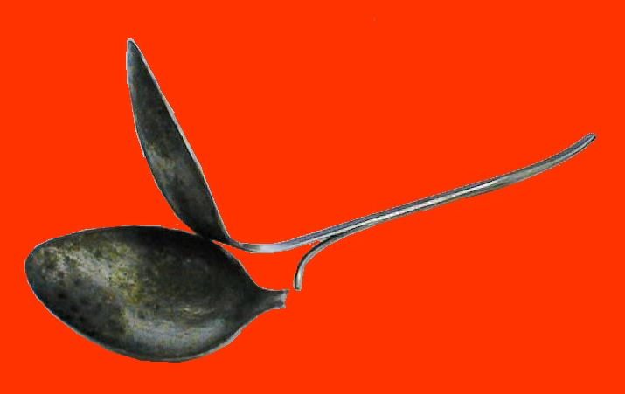
Differential Oxygen Concentration
Corrosion
Air
Zinc
Membrane
Sodium
Chloride
Solution
Deficiency of Oxygen Near Center of Spoon
Made From 2 Clad Layers Caused Corrosion of Stainless Steel
Notes:
Slide 14
Differential Oxygen Concentration Corrosion Cells
This type of corrosion has several different names: Crevice corrosion, oxygen concentration corrosion, and oxygen starvation corrosion. The left schematic illustrates what happens when two pieces of the same metal (in this case zinc), are immersed in a neutral electrolyte, such as sea water separated by a membrane that allows the passage of ions but not oxygen. If air (i.e., oxygen) bubbles over the zinc on the left side of the membrane, a corrosion current will begin to flow. The zinc on the right side of the membrane, having only limited oxygen available, will act as an anode and corrode, while the other zinc rod will act as the cathode, at which O₂ is reduced in this corrosion cell.
The illustration at the top-right shown what happens if a drop of water falls on a clean steel surface. The middle of the drop contains only about 9 ppm oxygen while at the edge of the drop the oxygen concentration is about 200,000ppm. The difference in oxygen causes the steel to corrode at the point where the oxygen is most deficient (the center of the drop). After some time, a corrosion pit will be visible at the center of the drop and a red stained ring will be present at the circumference of the drop. The red stain is caused by iron hydroxide precipitating at the more alkaline pH produced by the corrosion cell.
When an adsorbed moisture film is present on a metal surface, a similar type of differential aeration corrosion cell also may exist when overlapping surfaces of the same metal form a crevice. The inside surfaces of such an overlap will have less oxygen available than the remainder of the metal surface and will corrode preferentially. This is illustrated by the corroded stainless steel spoon in the illustration.

Slide 9
The Salt Spray Test
Differential Oxygen Corrosion Cells are accelerated by:
Elevating the temperature of the chamber (35 +/- 2°C [95 +/- 3]°F)
Adding sodium chloride (5%wt.) to make the cells more conductive
Inclining the test surface to prevent saturation of the corrosion cell

Slide 10
Barrier Coatings-Phosphates
Iron Phosphate
  Inexpensive minimal protection
  Coating weight =~35mg/ft²
  Always painted
  4-8 hrs. salt spray (bare)
Zinc Phosphate
  Excellent Corrosion Resistance
  Stand-alone or painted
  Light (150-500mg/ft²), Medium (500-1100 mg/ft²) & Heavy (1,000-3,000 mg/ft²) coatings
  24-500 hrs. salt spray (bare)
Cathode
Anode
Cathode
+
Cathode
+
–
–
–
–
+
Stress Anode
–
–
+
–
+
+
Phosphate crystals isolate anodes from cathodes

Slide 11
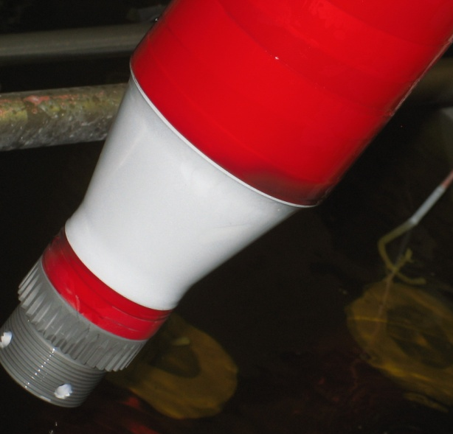
Anodic Deposits-Cadmium
Favorable galvanic couple with some aluminum alloys
Poor galvanic couple with titanium
Anodic to steel in a sea water (chloride) environment
Cathodic to steel in an acid rain (sulfate) environment
Excellent lubricity
Excellent solderability
Cadmium is toxic (not subject to bacterial-fungi growth)
Can grow “whiskers”
Do not apply to parts serving at temperatures > 450°F
Excellent corrosion resistance:
Cadmium Plated Aerospace Parts
Photo by: F. Altmayer
Notes:
Cadmium does not form a detrimental corrosion cells with aluminum allowing cadmium plated fasteners to hold together aluminum aircraft components. Cadmium is sacrificial to steel in sea water but not in environments containing sulfur (such as acid rain). Because cadmium has excellent lubricity, fasteners plated with cadmium can be separated many times and after a long period of environmental exposure.
Because cadmium is toxic, it will not allow detrimental organisms to grow on its surface. Such organisms often accelerate corrosion (via oxygen concentration cell mechanism we will describe later).
There is great interest in comparing zinc alloy deposits to cadmium (as a pollution prevention act, and due to phasing out of cadmium electroplating, a number of studies have been conducted, comparing possible substitutes.
Shown is data from a study conducted by John Stropke, of the Battelle Institute and Glen H. Graham, CEF, Tinker AFB (*Proceedings of 31st Aerospace/Airline Plating & Metal Finishing Forum, April 25, 1995)
Salt spray test was conducted on 4340 steel plated with 0.0005” (12.5 microns) of cadmium plus a dichromate conversion coating.
Note that a wide variety of salt spray performance was obtained.

Slide 12
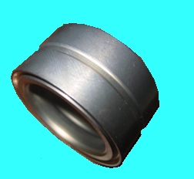
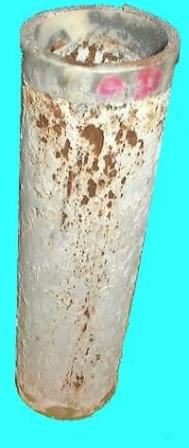
Anodic Deposits-Zinc/Zinc Alloys
  Zinc:
  Lowest cost galvanic corrosion protection
  Corrosion products are not aesthetically pleasing
  Zinc Alloys:
    Zinc- (5-14%) Nickel
    Zinc- (0.5-1%) Cobalt
    Zinc- (1-25%) Iron
    Tin- (25-30%) Zinc
  Higher level of corrosion resistance in salt spray vs. zinc or cadmium
  May not offer other properties such as low impact on fatigue, ease of hydrogen embrittlement relief, anti-galling
  May not be aesthetically pleasing
Corroded Zinc Plated Tube
Zinc-Nickel
deposit
Red Rust
2500
White Rust
2000
1500
1000
500
Zn
Zn-Co
Zn-Fe
Zn-5-7%Ni
Zn-10-12%Ni
Hours of Salt Spray Exposure per ASTM B117, 8 microns plus iridescent chromate
(data from Boeing)
Photo by: F. Altmayer
Notes:
A number of proprietary methods of applying zinc coatings exist. Shown is one of these. It involves immersing the parts to be coated in a fluidized bed of a proprietary mixture of metal powders and flakes. The combination shown has proven to provide sacrificial protection to steel, far longer than zinc or even cadmium plating.
that the alkaline zinc-nickel process is a suitable substitute for Ti-Cad plating (in select applications).
In the dip-spin process, the steel parts are cleaned and dried, prior to processing for coating. The parts are dipped into a fluidized bed of metal powder/flakes and centrifuged to remove excess powder. Following coating, the parts go through a curing oven (shown) that provides metallurgical bonding between the coating and substrate. Dip Spin Process:
1. Clean/Dry
2. Dip Spin (Centrifuge) Coating Application
3. Cure, 10 min. 150-300°F Followed by 15 min. 610°F
4. Cool Down, Seal (optional)
The parts to be coated must be able to withstand the high temperatures in the curing oven. The appearance of coated parts is typically not “decorative.” Also, dimensional tolerance does not quite match that obtained with electroplating methods.

Slide 13
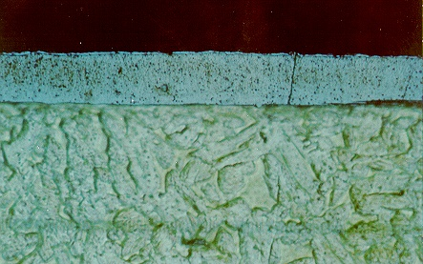
Cathodic Deposits-Electroplated Nickel
Deposits tarnish, especially in sulfur bearing environments
Often plated over steel, zinc and aluminum base metals (less noble than nickel)
Watts Solution
Most commonly used in decorative applications
Deposits are porous, impure (contain hydrogen, oxygen, sulfur, carbon, and chloride) and exhibit a tensile stress
Sulfamate Solution
Most commonly used in industrial, aerospace and electroforming industries
Deposits are more pure, less porous and internal stress can be controlled
Pore/Crack
Nickel
Steel
Corrosion Site
Porosity in a Watts Nickel Deposit
200
Pores/dm²
100
Range
50
20
0 .2 .4 .6 .8 1.0 1.2 1.4 1.6 1.8 2.0
Thickness, mils
Photo by: F. Altmayer
Illustration based upon ref 4
Notes:
Electroplated Nickel
When applied over steel, aluminum or zinc base metals, nickel is more noble and will not offer cathodic protection. Nickel is slightly less noble than copper in seawater, however.
Nickel plating may be applied to any one of numerous base metals for either a decorative or for an “industrial” application.
Heavy deposits of nickel can be plated from a number of chemical formulations, but those most often employed are:
The “Watts” formulation containing nickel sulfate, nickel chloride, boric acid, and a number of additives.
The sulfamate formulation containing nickel sulfamate, boric acid and a surfactant. The solution may also contain a small amount of nickel chloride, and additives to reduce stress and increase hardness.
Electroplated nickel tends resists tarnish and corrosion when exposed indoors in a controlled environment. When exposed outdoors, nickel tends to produce a dull basic nickel sulfate “tarnish” over time, especially in atmospheres containing sulfur dioxide (acid rain). For these reasons it is often over-plated with a thin layer of chromium, but in most cases, almost all of the overall corrosion protection comes from the nickel. Heavy coatings of nickel have been used on some aircraft exhaust systems where the nickel oxide produced by the hot exhaust gases is dense enough and adherent enough to protect the base metal from corrosion.
Nickel plating is a porous deposit until the thickness exceeds about 0.0016” (about 40 microns), as illustrated by the graph on the left. A crack or pore that travels through the nickel down to the base metal will allow a conductive liquid to set up a galvanic cell. Since nickel is normally plated over steel, zinc or aluminum, in all these cases, the nickel is the more noble metal and the base metal corrodes. In the case of steel, the corrosion results in red rust. With zinc and aluminum, the corrosion products are hydrated oxides which have a much higher volume than the metal, thereby pushing up on the plated deposit and producing gross blistering.

Slide 14
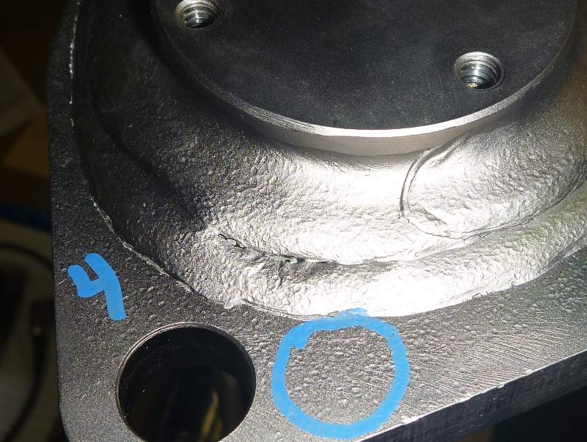
Cathodic Deposits-Electroless Nickel
Corrosion Resistance Affected By:
%P in the deposit (higher %P = higher performance
Plating thickness
  ASTM B733 Thickness/Salt Spray Req.:
    SC-2 = 13µm/24 hr. salt spray
    SC-3 = 30 µm/96 hr. salt spray
    SC-4 = 60µm/240 hr. salt spray
Heat Treatment
  SS performance = ~100X poorer
Surface finish of the base metal
PO₃ content (80g/L max )/age of solution
Purity of the deposit:
Porous weld
Rough Surface
Rough, porous surfaces lead to early corrosion failures
Corrosion Rate*
%P % Impurity µm/yr mils/yr
10 nil 5 0.2
11 0.04 Sn 7 0.3
8 0.05 Cd 24 0.9
10 0.12 Pb 15 0.6
8 0.13 S 15 0.6
10 0.05 Pb & 0.08 Cd 11 0.4
* In C0₂ saturated, 3½ percent salt brine at 95°C (200°F).
Notes:
Electroless nickel is more noble than most any base metal over which it is applied. For this reason, the plating thickness and low level of porosity are the main factors involved in providing good corrosion protection.
Other factors affecting corrosion resistance include:
Surface Condition
When EN is applied over a smooth surface, corrosion resistance is improved. Do not sand blast, if at all possible.
Do not pickle in strong acids just prior to the EN solutions, especially in hydrochloric acid, as chlorides trapped in crevices will cause corrosion.
Double dip zincate on aluminum parts
Operate at the low end of the pH range (higher P and lower stress)
Use high phos solution for highest corrosion resistance
Use a solution low in impurities
Impurities and by-products produce more defects in the deposit
Chromates (example; Iridite 14-2) over EN can increase salt spray performance but may discolor the deposit. Some chromates (example; Iridite 14-6L) can chromate bare areas of aluminum while passivating the EN, without discoloration.
Apply chromates immediately after plating.
Heat treatment will reduce corrosion resistance dramatically but heat treatment at lower temperature for improved adhesion will not. Heat treatment at very high temperature (>600C) may actually help corrosion resistance by producing an oxide film over the EN.
Because electroless nickel is a barrier coating, severe and very severe service conditions require a substantial thickness of a defect-free deposit. In general the thickness of the coating required depends on service condition, the substrate metal, and surface smoothness.
Rough, non-uniform substrate surfaces require thicker coatings than those specified in order to obtain minimum porosity and maximum corrosion resistance. The salt spray resistance of most EN deposits can be significantly increased by a dichromate post-treatment. Either hot dilute [~1%] chromic acid or proprietary compositions are used.
This slide shows the EN minimum thickness requirements in the ASTM B733 Specification for various service conditions. Coating thickness of 5 to 25 microns (0.2-1 mil) are most frequently used.

Slide 15
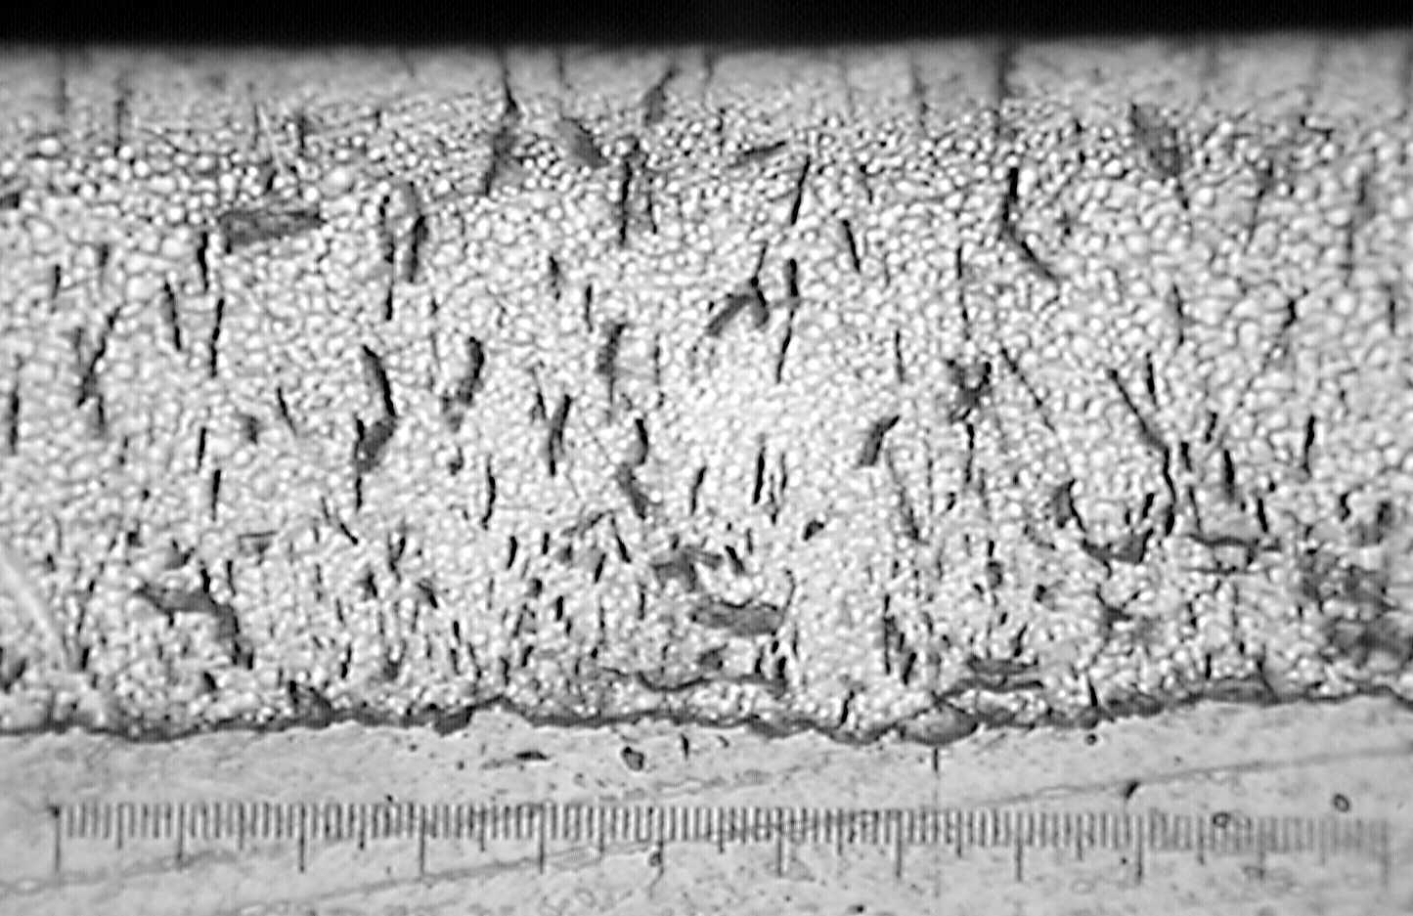
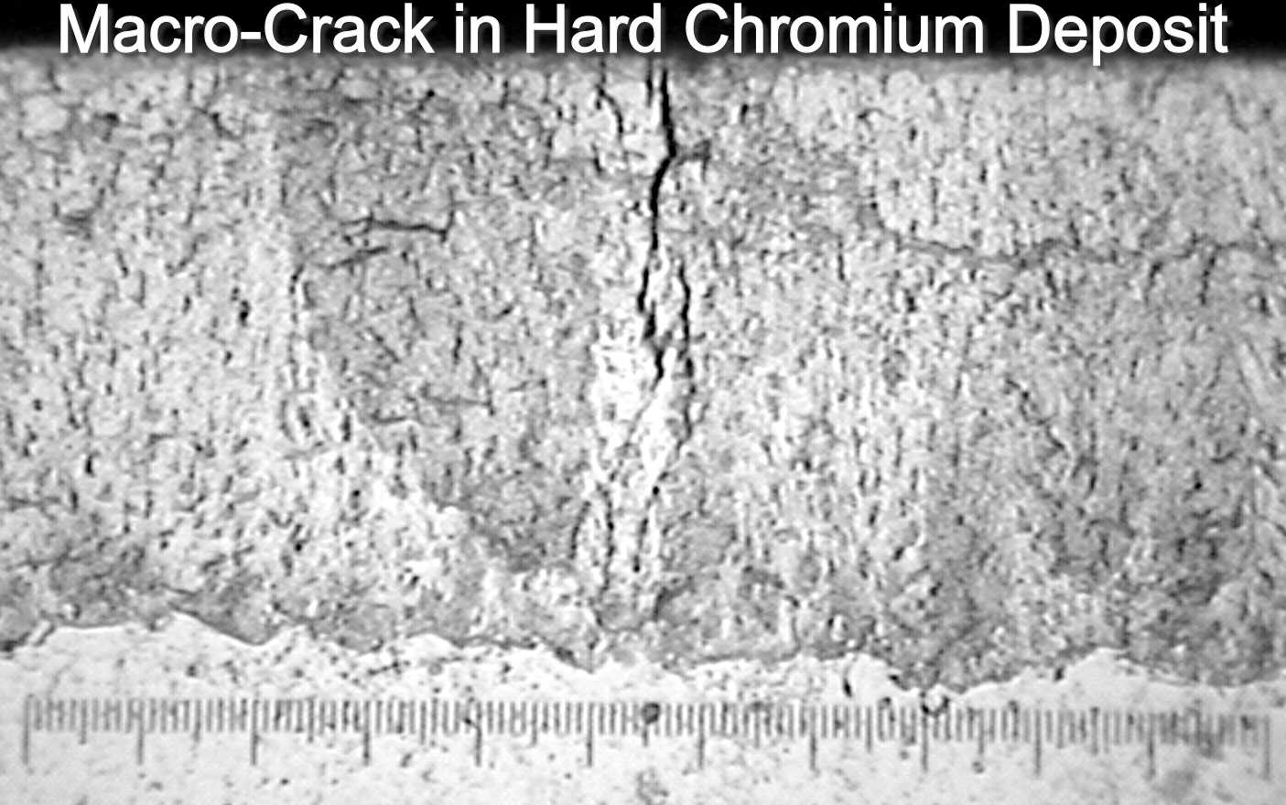
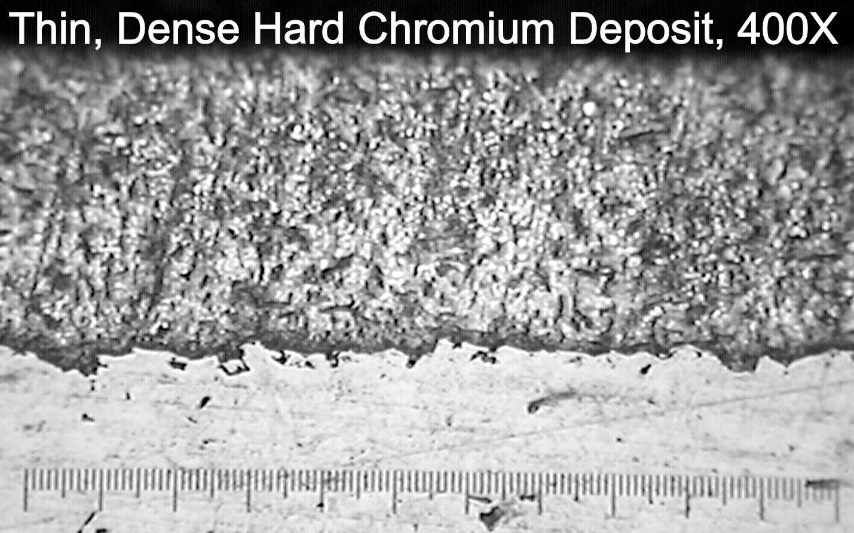
Cathodic Deposits-Chromium
Decorative Applications:
  Highly desirable bright blue tint (decorative applications)
  Highly passive due to oxide formation
  More noble than nickel under-plates
  Micro-cracked/microporous structure enhances corrosion protection of the nickel underplate
  Size and crack/pore density affects corrosion resistance
  CASS performance is typically 96-120 hrs.
Hard Chromium Applications:
Brittle
  Macro-cracking can lead to corrosion failure
  Poor fatigue properties
Microporous structure can hold lubricant for added wear resistance in hard chromium applications
Salt spray resistance for 1-2 mils over steel = 32-72 hrs.
A “thin-dense” deposit has 2-3X the salt spray performance of regular hard chromium
100X
Cross section of “normal” crack pattern
100X
Cross section of an undesirable “macro-crack”
Photos by: F. Altmayer
Notes:
While in theory hard chromium deposits are typically protected from corrosion by a clear oxide film, the reality is that the chromium deposit has a multitude of microscopic cracks (see photos) which can vary in size and density, providing paths for corrosive ions to be transported to the steel substrate. As a result of the presence of these paths hard chromium deposits are typically not very corrosion resistant and yield only 32-72 or 90 hours of salt spray performance before the onset of red rust. The performance is even worse if large macro-cracks such as might be produced by heat generated during aggressive grinding are present.
Hard chromium is much better at resistang corrosion under lubricated conditions since such lubricants can fill the cracks creating a barrier for any corrosive ions.
While chromium is listed as having a -.71V single metal potential in the EMF series, this value applies for chromium in the “active” state (no oxide present). Electroplated chromium is almost always in a passive condition (oxidized), and under such conditions it can be considered to be highly noble. When plated over nickel or steel, chromium is the more noble metal and therefore corrosion of the underplate is essentially unavoidable, as the brittle chromium tends to crack producing avenues for corrosive liquids to set up galvanic cells.
By forcing the chromium to develop numerous cracks or pores as it is plated (by proprietary means), the current produced by the galvanic cell between the chromium and the nickel underplate is spread over a very large surface area, thereby reducing the dissolution (corrosion rate) of nickel dramatically.
As shown, however, conditions that produce macro-cracking in the chromium and nickel underplate (large temperature shocks for example) must be avoided.
Thin dense chrome plating is generally applied to interior surfaces and inside diameters. It allows for
closer tolerances, better surface finishes, better uniformity, and tends to reduce or eliminate subsequent
grinding or honing of the plated surfaces
Thin dense chrome plating is applied very slowly, as compared to hard chrome plating. It has
substantially greater density and higher hardness; approximately Rockwell C-70 versus Rockwell C-65
for hard chrome plating.
Prior to plating, the surface should be as smooth as possible and should not exceed 10 microinch RMS
(0.229 microns Ra). After plating, stress relief may be necessary to reduce stress cracking.
Thin dense chrome plating is recommended over hard chrome plating when in contact with BAL Seals,
but it has the limitation of a very small thickness that may tend to wear through at high speeds. Wet
lubrication is recommended as a means to provide reduced friction and improved wear resistance of
the mating surfaces.
Dry lubrication is not recommended in thin dense chrome plating, because there is no positive means
for locking the dry lubricant to the plated surface since the plating is very smooth.
Electrolizing Company reports coefficients of friction from 0.04 to 0.09 with
this thin dense plating alloy.
Requires Surface finish from 4 to 10 microinch RMS (0.071 to 0.229 microns Ra) prior to
plating, with no visible nicks, marks, or occlusions.

Slide 16
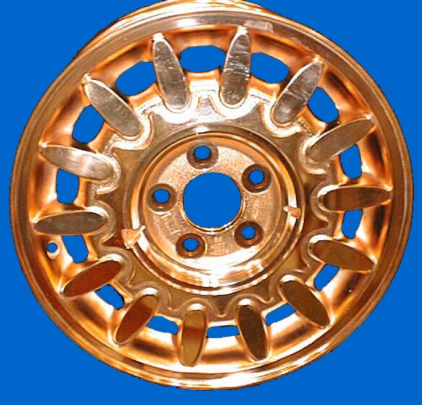
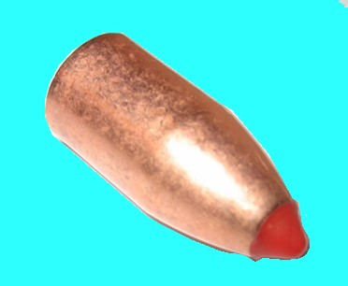

Cathodic Deposits-Copper
Features:
Pore-free fine grained deposit can increase salt spray performance, when used as an under-plate
High ductility
Almost always used as an “underplate”
Disadvantages:
More noble than most over-plated metals (nickel, chromium)
Bare copper develops a green patina composed of basic copper sulfate (CuSO₄ · 3Cu(OH)₂ · H₂O) + copper oxychloride H₆Cl₂Cu₄O₆
Copper Plated Auto Wheel
Copper Plated Projectile
Notes:
While most decorative nickel-chromium plating specifications allow for a copper underplate, it is typically not mandatory. However, a heavy deposit of copper can act as a pore free barrier, protecting the base metal from corrosion.
The coefficient of thermal expansion for copper (16 x 10⁻⁶/°C more closely matches that of aluminum (24 x 10⁻⁶/°C) than nickel (13.5 x 10⁻⁶/°C). The combination of aluminum and copper produces a lower level of shear force than aluminum nickel, resulting in less tendency towards adhesion losses.
Copper is far more ductile and more easily buffed than nickel. An acid copper layer can be used to buff plated castings that have minor surface flaws (defects almost too small to see by eye). However, this should not be considered to be a remedy for castings that have surface pits larger than that which can barely be seen.
A disadvantage of using copper directly over aluminum is the fact that copper is more noble than nickel, setting up a battery that is about 2 volts vs. 1.5 volts for nickel-aluminum, if a corrosive liquid ever gets down to the base metal through a pore.
Copper is typically not used as a corrosion protective coating since it is readily attacked by a number of corrosives and can be embrittled by ammonia and ammonium containing compounds. However, copper is very ductile and can serve as a good under-plate for other more protective layers of plated metals.
Heavy (2-3 mils) copper deposits can also be used as carburization stop-off since dense copper deposits acts as a barrier to carbon diffusion.

Slide 17
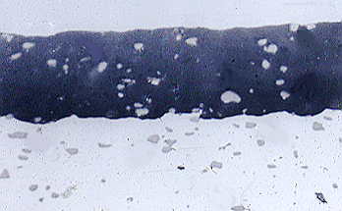
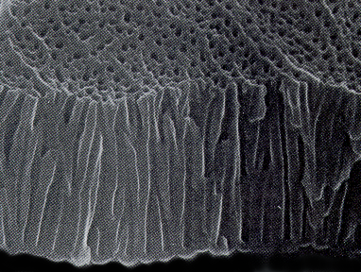
Barrier Coatings-Anodized Aluminum
Aluminum Oxide
Serves as a non-conductive barrier to corrosive environments
Is highly porous and a poor corrosion resistive coating when un-sealed
Is attacked by acidic or basic solutions
Corrosion resistance depends on:
  Thickness of anodic coating
  Aluminum alloy
  Base metal surface finish
  Anodizing solution used
  Anodic coating quality
  Quality/Type of sealing
    Dichromate (best)
    Hot water
    Nickel/Cobalt Acetate
Cross section of anodic coating
SEM Photo at 50,000X from “The Surface Treatment and Finishing of Aluminum and its Alloys” Finishing Publications
Notes:
Freshly produced anodic coatings on aluminum are mostly composed of aluminum oxide (Al₂O₃) containing traces of sulfates, chromium (TI coatings only) and oxides of alloying elements. In combination these ingredients are highly non-conductive. However, a freshly produced coating is also highly porous. As many as half a billion “holes” per square inch may travel from the top of the coating to within less than a micron of the base metal surface.
Following anodizing (and coloring operations, if any), a “sealing” step closes these pores to render the coating a viable corrosion resistant barrier against most all corrosive environments, except those that are highly acidic or alkaline.
The over-all corrosion resistance of anodic coatings over aluminum depend heavily on the parmeters listed here. The thickness (sometimes measured by “weight of coating”), surface finish of the base metal and quality of the sealing step are major factors in providing salt spray performance, which is typically specified at a level of 168-336 hours.
Sealing can be conducted in numerous chemical solutions as well as in plain hot deionized water. It is generally recognized that dichromate seals provide the best corrosion resistance, but they impart a yellow tint, that may be cosmetically undesirable. Hot water is next best and is used on parts that are not colored by dyeing (the water leaches the dye from the pores). Nickel and/or cobalt acetate are used on dyed parts as they act to seal the pores in the shortest time. When well controlled all sealing steps can produce an anodic coating that is an effective corrosion resistant barrier.

Slide 18
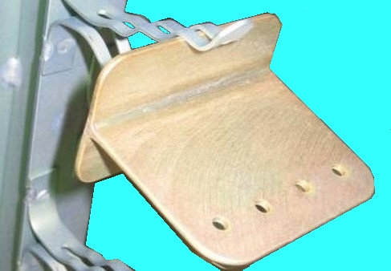
Barrier Coatings-Chem Film
Chromates on Aluminum Parts
Serve as a non-conductive barrier to corrosive environments
Salt spray performance depends on:
  Processing conducted to prepare the aluminum for chem film
    Type of cleaner used
    Deoxidizer type and process control
  Base metal alloy
  Base metal surface finish
  Thickness of coating
  Age of coating (24-48 hours minimum)
Chem film coating on aluminum part
Notes:
Shown is a summary of the recommendations made by the Boeing experts. Some of these apply only to a chem film process, but many are valuable suggestions for many other types of processes.

Slide 19
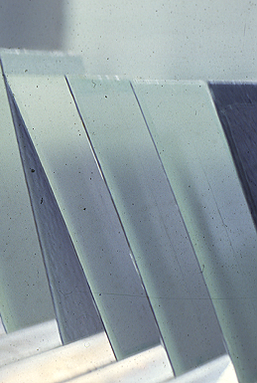
Salt Spray Test Failures
Failures on test panels:
May be caused by the finishing process employed
May be due to operational issues with the test chamber
May be related to the condition of the test panels, which must be carefully purchased, stored, and chosen for the test
Panels touching and shading each other during the test can produce varying test results

Slide 20
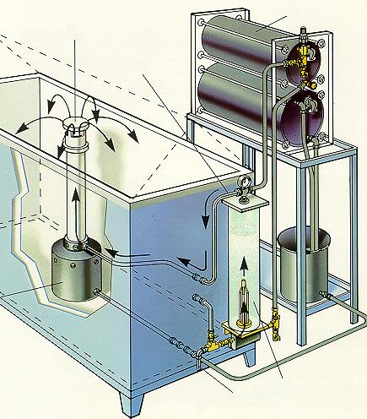
Was The Test the Cause?
The Salt Spray test (ASTM B117) is imprecise
Equipment Variables:
    Cabinet size
    Venting of the chamber
    Materials of construction
    Method of salt solution feed
    Cabinet heating method
    Atomizer design/orifice (0.02-0.03”)
    Saturation of compressed air
    Spraying system design

Slide 21
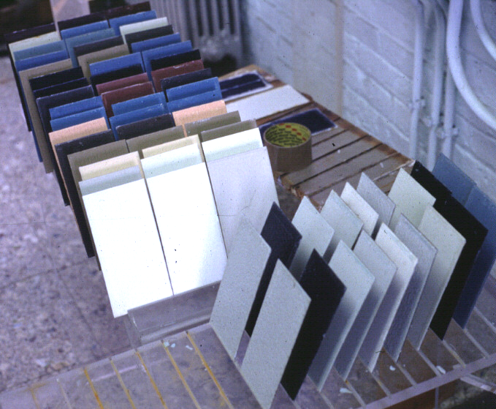
Was The Test the Cause?
Operational Issues:
Atomization Pressure (10-25psi
Salt Collection Rate (1-2mL/hr)
Salt concentration (1.025-1.040 spg)
Exposure Temperature (92-97°F)
pH of collected spray (6.5-7.2)
Periodic evaluation of test chamber using the ASTM B117 recommended “Corrsivity Test” on steel panels

Slide 22
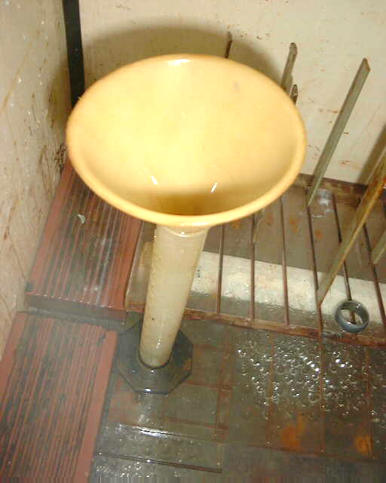
Salt Fog Collectors
  A 10 cm diameter glass or plastic funnel placed into a rubber stopper placed into a collection vessel (graduated cylinder works well)
  80cm² collection area
    10cm dia. funnel = 3.14 x 5 x 5 = 78.5cm²
  1st placed as close to atomizer as closest sample
  2nd placed as far away from the atomizer as the farthest sample
10cm dia. funnel
10 cm
Stopper
Graduated Cylinder

Slide 23
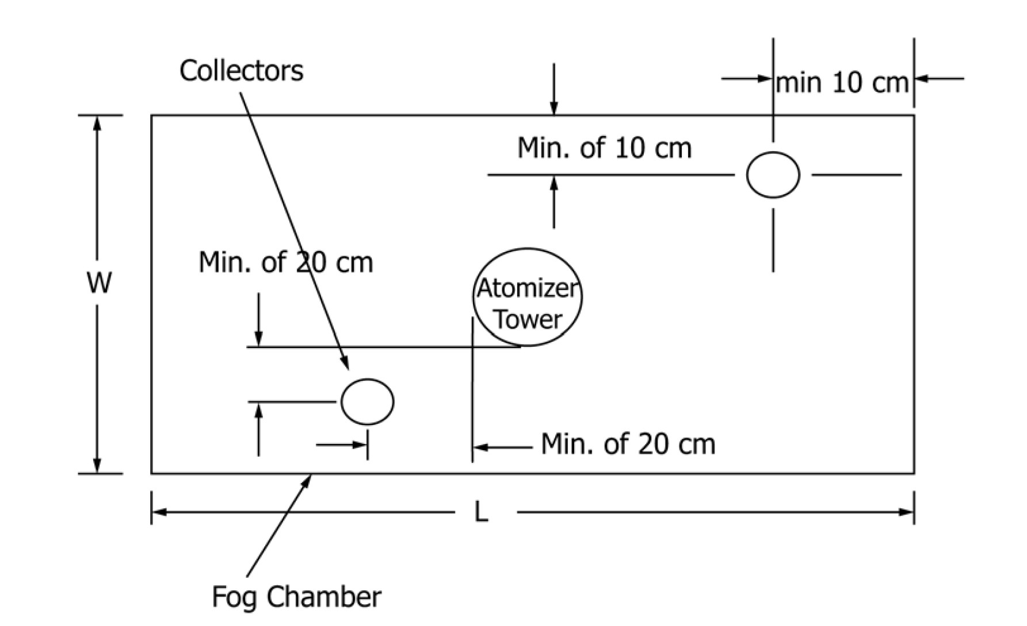
Salt Fog Collectors
    Do not follow the diagram in ASTM B117:
    NADCAP auditors may write you up for non-compliance (According to Bob Adams, NADCAP audito, rbaauditor@gmail.com)
  Salt fog may be collected inside the cabinet and routed to the exterior for continuous monitoring
  Do not allow condensation to enter the collection flask by alternate routes

Slide 24
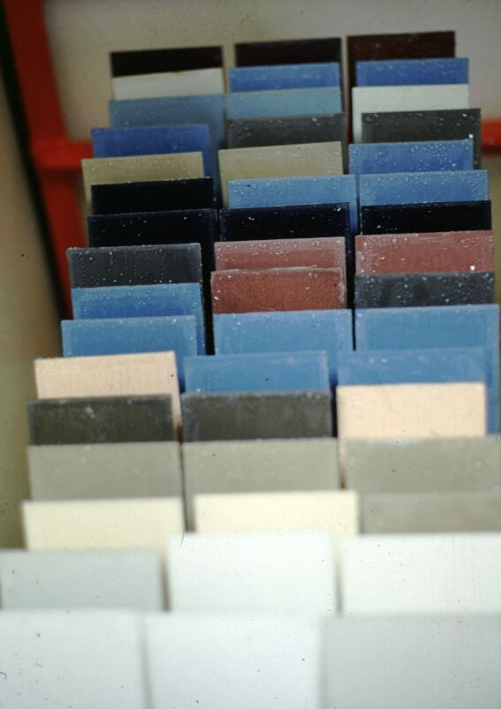
Was The Test the Cause?
Specimen Exposure:
Test panels with holes facing down
Test panels parallel to salt fog flow
Specimen supported from bottom
Specimen not touching each other
Specimen protected from direct spray impact
Exposure period not interrupted
Specimen not dripping on each other
Panels not handled with bare hands
Panels not shading each other

Slide 25
Was The Test the Cause?
4-8º
15-30º
Drop runs off preventing saturation
Drop remains for an extremely short time, runs off
Drop rests too long, saturating the drop

Slide 26
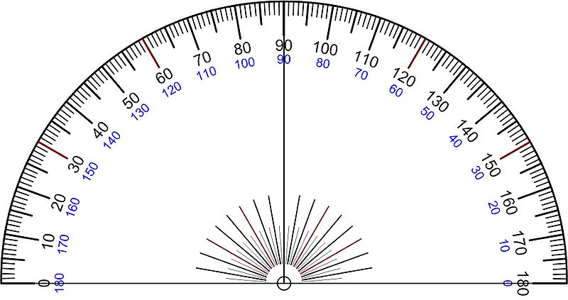
Was The Test the Cause?
Specimen Exposure:
Panels at correct angle and orientation
MIL-DTL-5541 = 4-8º
Boeing 5632 = 6º
ASTM B117=15-30º
Fog Flow
6º
15-30º

Slide 27
Salt Spray Test Failures
Was the process at fault?
  Additional Advice* for BSAA Anodizing:
  Measure/monitor Anodizing Current density
    Use clamp meter on loaded rack & compare against reading of nearby un-loaded rack
    Boeing recommended CD = 4.6 A/ft²
  Verify Seal Quality
    Hydration test per BSS 7325
    Kape Test (Sodium sulfite) or ASTM B680 (chromic-phosphoric)
Courtesy of Mr. Bill Heeter, Skills Inc., Seattle WA

Slide 28
SS Failures on Alodine
Was the Alkaline Cleaner at fault?
Boeing/Consultant Guidelines:
All (9) sets of 2024 T-3 test panels processed in non-etch alkaline cleaners passed a 168 hour salt spray test
4 out of 7 sets 2024 T-3 test panels processed in an etch-type cleaner produced salt spray failures (severe pitting)
If etch cleaners are required:
Best results are obtained with etch rates between 0.17 to 0.22 mils/side/hour

Slide 29
SS Failures on Alodine
Was the De-ox at fault?
Boeing/Consultant Guidelines:
Deoxidizing is considered the most important or second most important step in obtaining good salt spray results (after test panel selection)
Time in deoxidizer is considered critical
2-3 minutes, with 2 minutes preferred by most experts
Reduce time to 1 minute max in older deoxidizer solutions (7,000-11,000 ppm Al)

Slide 30
SS Failures on Alodine
Was the De-ox at fault?
Boeing/Consultant Guidelines:
~50 ppm Copper in Deoxidizer yields salt spray failures
Some proprietary Deoxidizers (Am Chem 7-17) are designed to chelate copper and offer superior results
Chloride >350ppm can cause salt spray failures, but at least 12ppm was found desirable
Zinc & iron were mentioned as being problematical (no concentrations were given)
If possible, replace deoxidizer at “1 turnover”
Store 2 gallons of AM Chem 7-17 and use as referee

Slide 31
Salt Spray Test Failures
Was the Alodine® Solution at fault?
Boeing/consultant’s guidelines:
The Alodine® bath is not critical to good salt spray tests
There are diverse opinions on optimum conditions
If the Alodine® bath is operated under conditions which give "good" coating weights without powder, is not overloaded with aluminum, and is not contaminated with chlorides or sulfates, the bath will not be the cause of salt spray failures.
Recommendations for optimum pH range varied from 1.5-1.6 to 1.8-2.0
Use 25-50% of old chem film solution when making up a new one

Slide 32
Salt Spray Test Failures
Was the Alodine® Solution at fault?
Boeing/consultant’s guidelines:
Chloride over 200ppm, sulfate over 600ppm or Cl+SO₄ >800ppm produces powdery coatings
Alternate expert indicates chloride should be below 400ppm
General consensus was coating weight is unrelated to salt spray failures. Alodine® supplier recommended 40-60mg/ft².
Cr⁺³:Cr⁺⁶ should be </= 1 or make a new solution (keeping 25% of old)
Higher temperatures (85ºF vs. 70ºF) perform better

Slide 33
Salt Spray Test Failures
Was the Rinsing at fault?
Boeing/consultant’s guidelines:
Supplier of Alodine® recommended not to use DI rinse after deoxidizer as it may passivate the surface
Rinse time after deoxidizer <1 minute
One finisher adds 50ppm SO₄ to the rinse after de-ox
Hot rinse after Chem Film <140ºF (BAC5719 specifies 2 cold rinses after chem film)
Last rinse after Alodine should be <750ppmTDS
Drying temperature <120ºF, or air dry at room temp

Slide 34
Salt Spray Test Failures
Were the test panels at fault?
Boeing/Expert Guidelines:
Test specimen selection is considered one of the primary variables in obtaining good salt spray results on Alodine and BSAA processes
  Panel quality can cause >10:1 difference in test results
  Panels must be carefully screened to ensure they are corrosion-free and free of visible defects
  Impurities such as segregated copper or silica rolled into the surface may not be effectively removed during cleaning/deoxidize
  Panels may require polishing/lapping to obtain more consistent results
  May need to purchase a large quantity and screen panels for quality

Slide 35
Salt Spray Test Failures
Were the panels at fault?
How old were they before Chem Film?
  No more than 3-6 months).
  Polish older panels to produce a new surface
How were they stored before Chem Film?
  To lengthen storage life, the test panels should be kept in a desiccator and (ideally) be wrapped in plastic.
  Do not let panels touch each other (insert plastic liner)
How old were they after chem film and before salt spray?
  24-48 hour wait before salt spray is recommended.
How were they stored after chem film and prior to Salt Spray?
  Do not wrap in paper, plastic, let panels touch each other or use a desiccator

Slide 36
The End!

